Slide 1
KI 65
Kehillat Israel’s 65th Anniversary Commemorative Yearbook
Cantor Chayim Frenkel

Slide 2
Goals
Raise $500,000 for Kehillat Israel
Mark the 65th anniversary of Kehillat Israel

Slide 3
Strategy: Yearbook
Leadership included two chairs and Chayim
$150,000 budget raised during a previous event
25 committee members
Members included:
Congregation members that were well connected
Creative talent
IT support
Book publisher
Designers
People who could get things done
Each member was required to call 20 people
Outreach included emails, facebook, website, phone calls and face-to-face conversations
Choose auxiliary groups within the community to highlight in the book as well.

Slide 4
Goals…of the network

Slide 5
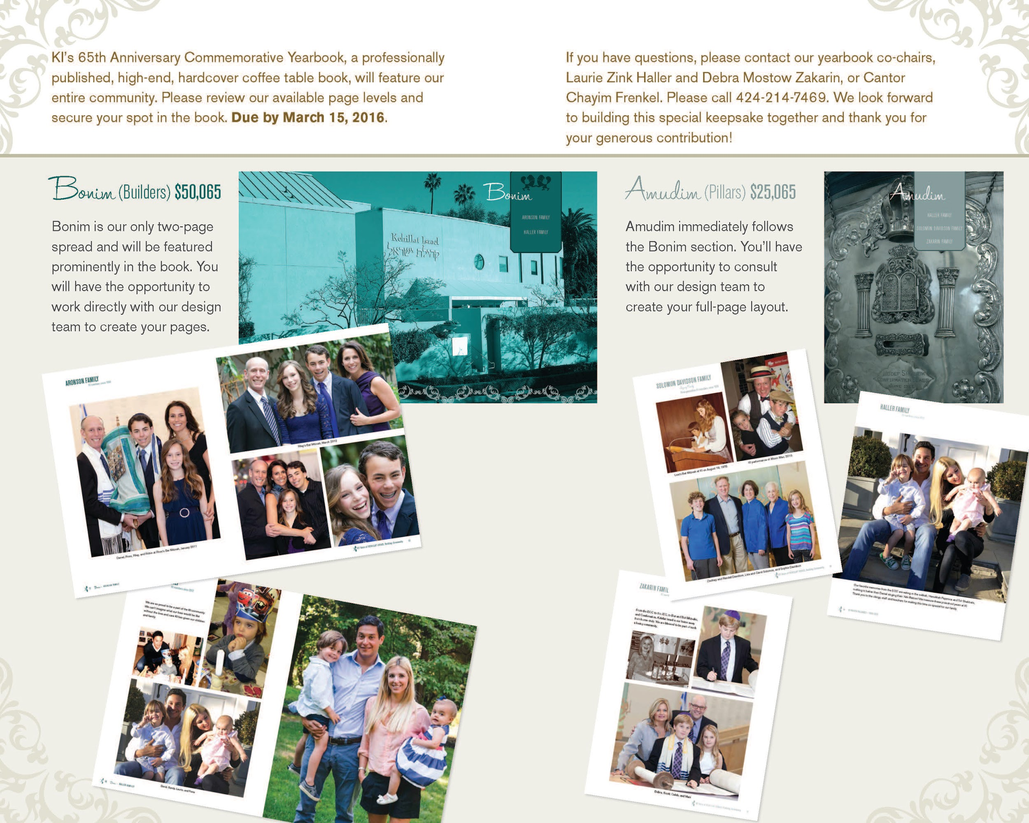

Slide 7
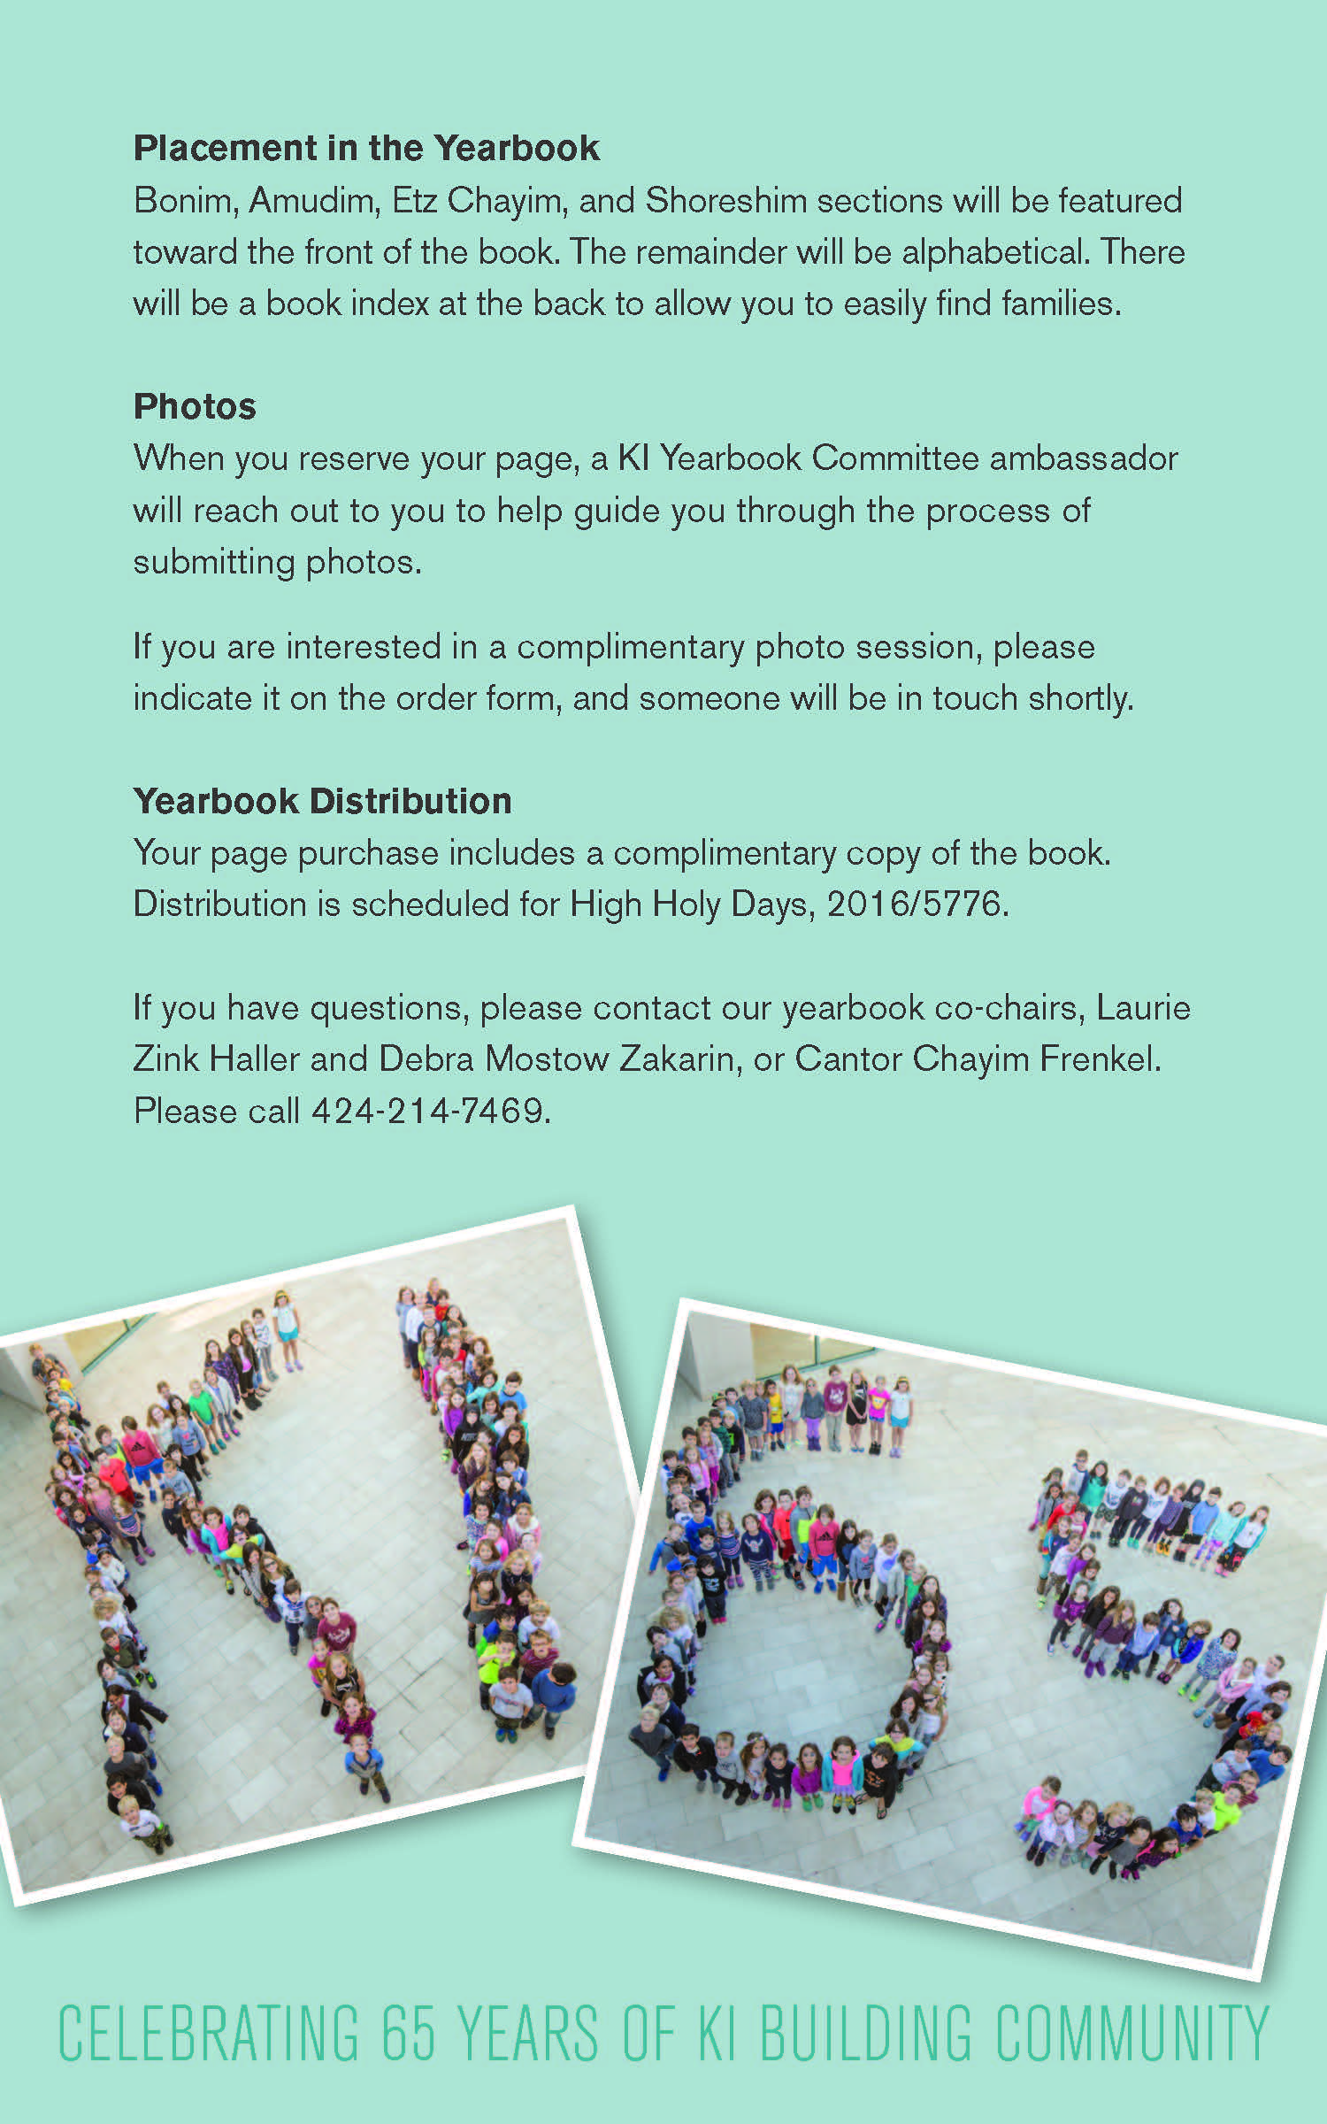

Slide 8
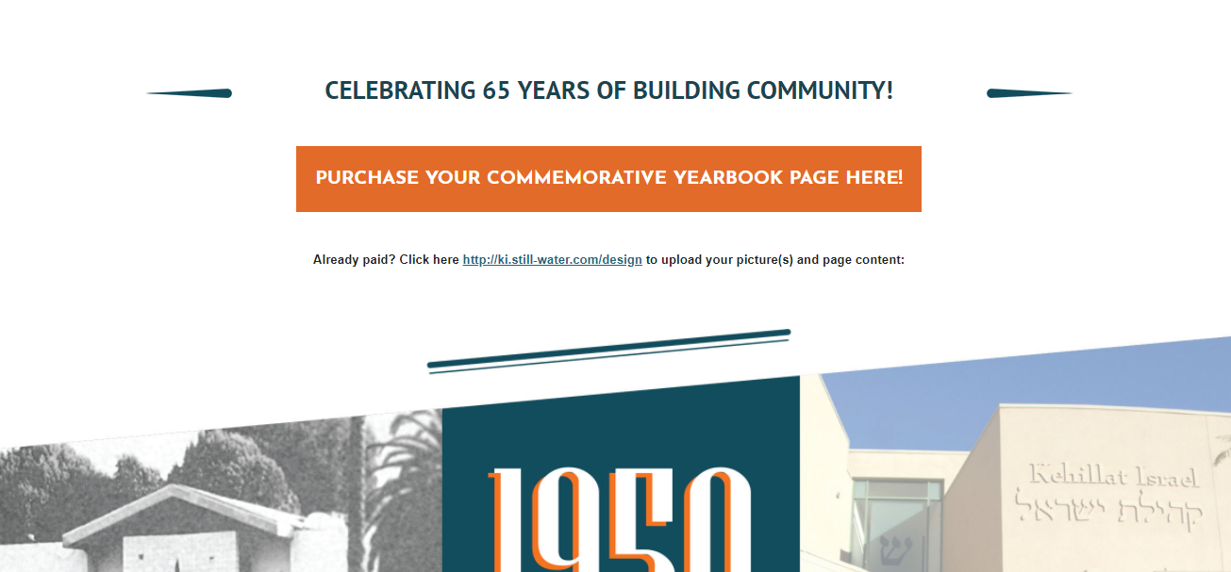
Our Website

Slide 9
Promotional Video

Slide 10
One page
Auxiliary groups
Two page

Slide 11
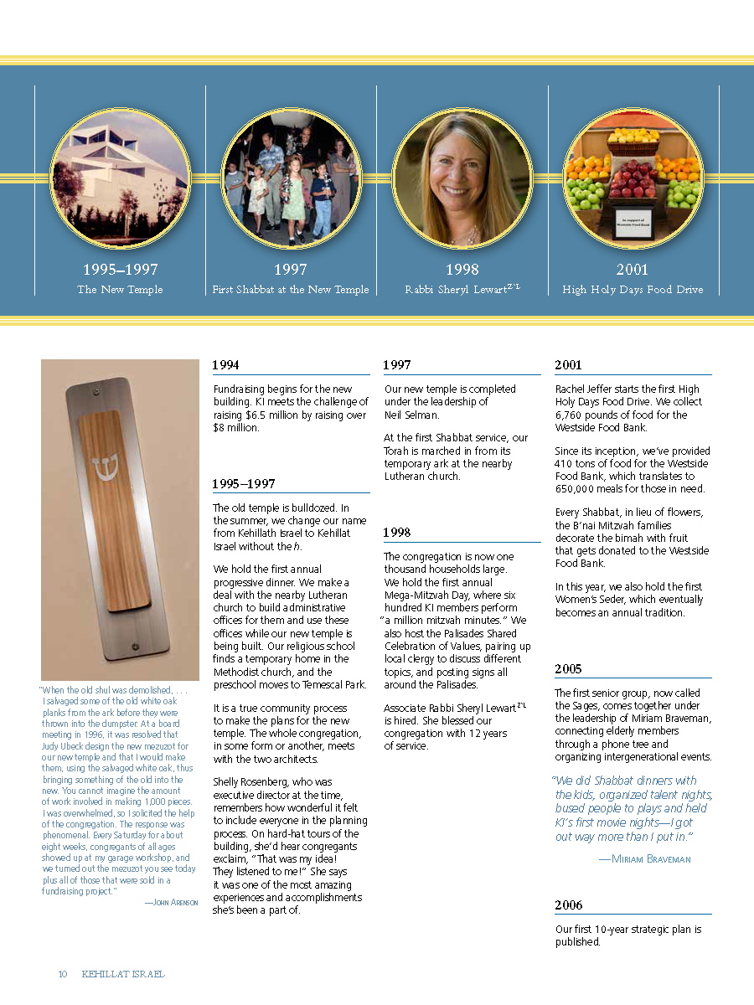
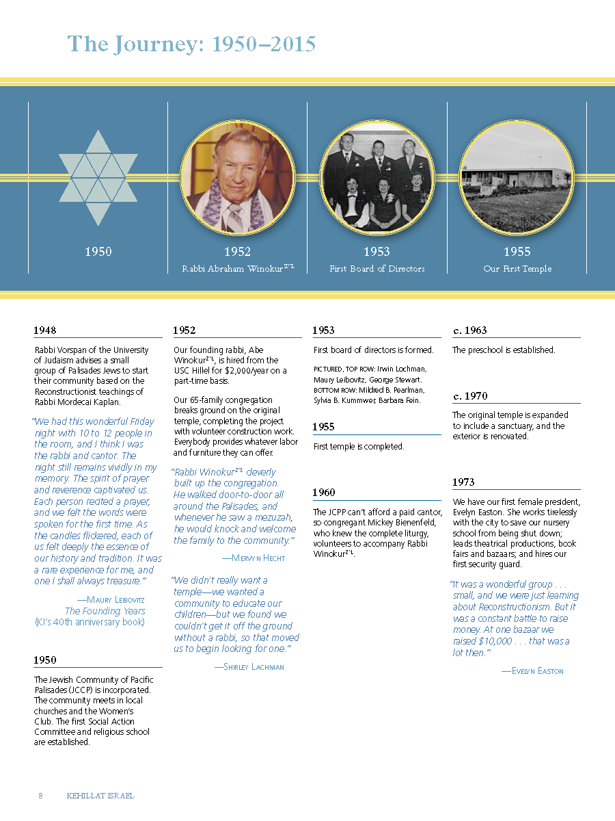
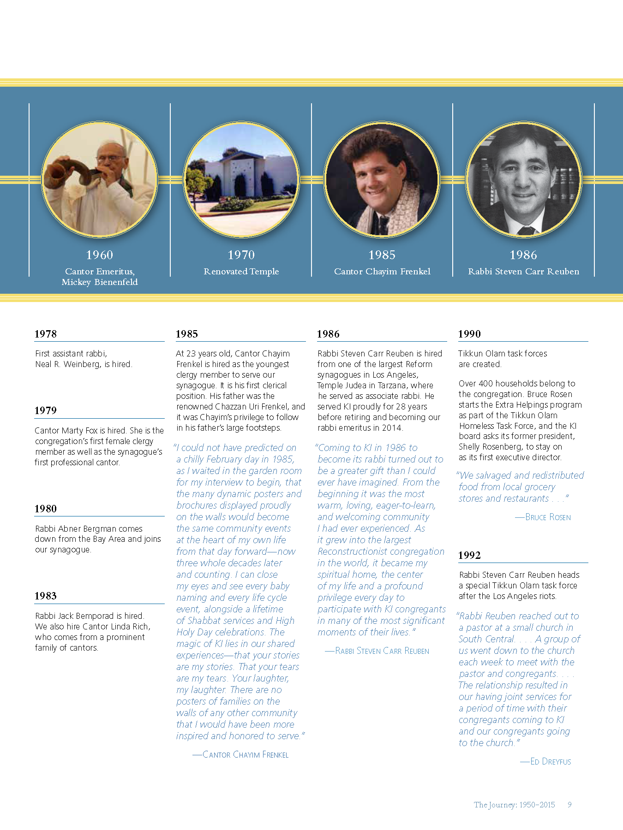
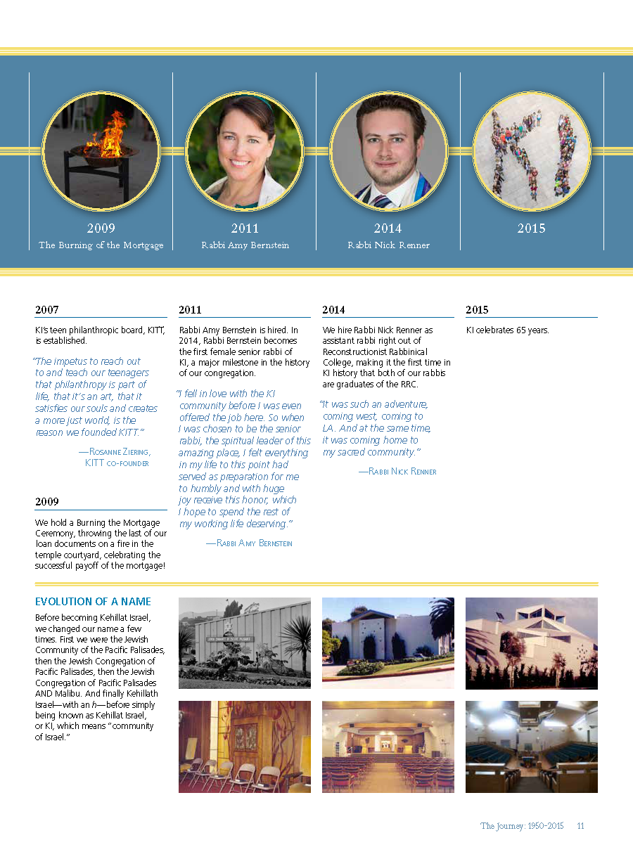

Slide 12
Results
The project took 2 years to complete (1 year of fundraising)
The book was 400 pages, 750 families participated (80% participation)
100% participation from the board of trustees
Raised $1.2 million dollars

Slide 13
Challenges and Lessons Learned
There were no pictures from the 1960s and 1970s in the congregation’s archive.
If you can, take pictures in your community consistently and store them in a place easily accessible
Website made the fundraiser easy to promote
In a world of digital media, the committee was surprised to find that the community supported the idea of having a book in hard copy
Many people did not have quality pictures.
Chayim and a volunteer offered to take family portraits for free if the family agreed to participate in the fundraiser.
Hired a designer but quit because the project became too big
The largest donations where done face-to-face and required some cultivation.
Must have a strong distribution plan

Slide 14
Resources
Our website: http://ki.still-water.com/
Our brochure: http://ki.still-water.com/pdf/KI_Brochure.pdf
Our video: http://ourki.org/wp-content/uploads/2017/08/Yearbookpromovideo.mp4?_=1
Formsite (for our online forms): https://www.formsite.com

