Slide 1
Dorshei Emet Torah Project Torat Imeinu… scribed by a woman, treasured by all.
A highly successful project for community building, outreach, and fundraising
Jeremy Becker

Slide 2
Goals
In its initial stages, the project was intended to raise funds to acquire our first ever new Sefer Torah
Ultimately, it became a much bigger project…
It unified the congregation around an exciting project
We raised our profile in the wider Montreal Jewish community through print, radio, TV, and events
We raised $ 630,000 to fully retire our debt and seed an endowment fund
We offered every congregational family the opportunity to participate, and opened the door for non-members too.

Slide 3
Year 1—Planning
The first year was spent in a tiny group:
Developing an outline of the steps and tasks needed for success
Researching other Torah projects from across North America
Recruiting a Dream Team of marketers, programmers, & fundraisers
Creating marketing materials
Approaching key givers for early commitments

Slide 4
Timeline
 | Nov | Dec | Jan 09 | Feb | Mar | Apr | May | Jun | Jul | Aug | Sep | Oct | Nov | Dec
Dedication opp’s •• |  |  |  |  |  | •
Website • |  |  |  |  |  | *
Weekly online updates |  |  |  |  |  | * | * | * | * | * | * | * | * | *
Media Planning (Print/Radio/Electronic) |  |  |  |  |  | •
Plasma donation update |  |  |  |  |  | ?
Pledge contracts •• |  |  |  |  |  | ?
Acknowledgement card |  |  |  |  |  | ?
Invitations •• – March 3 Launch 2onQuill Dedication Programs Other visits |  | * |  |  |  | √ ?
Letterhead •• |  |  |  | √
Naming | √
Logo •• |  |  | √
Brochure •• |  |  |  |  |  | *
Booklet (dedication) • |  |  |  |  |  | ?
Certificates • |  |  |  |  | √
Greeting Cards • |  |  |  |  |  | ?
Bulletin Inserts • |  | * |  | * |  | *√ |  | * |  | * |  | * |  | *
Photo/Video
• To be printed
• Created electronically
√ Done

Slide 5
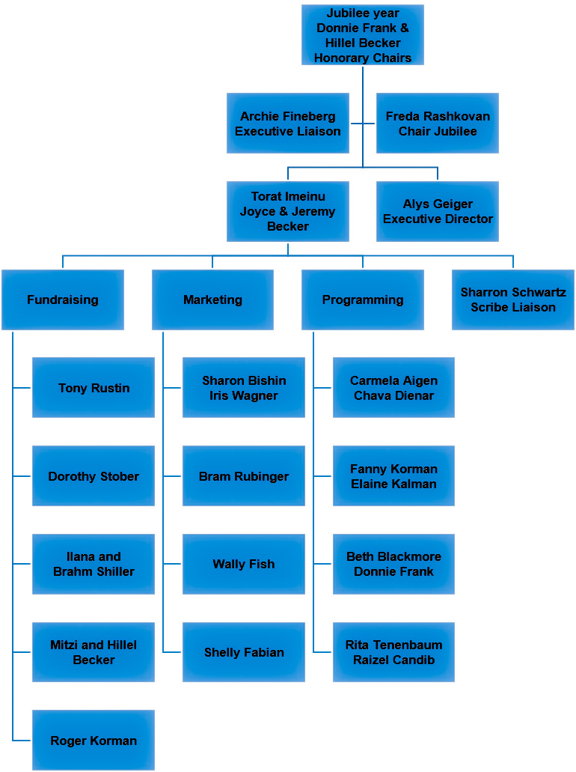

Slide 6
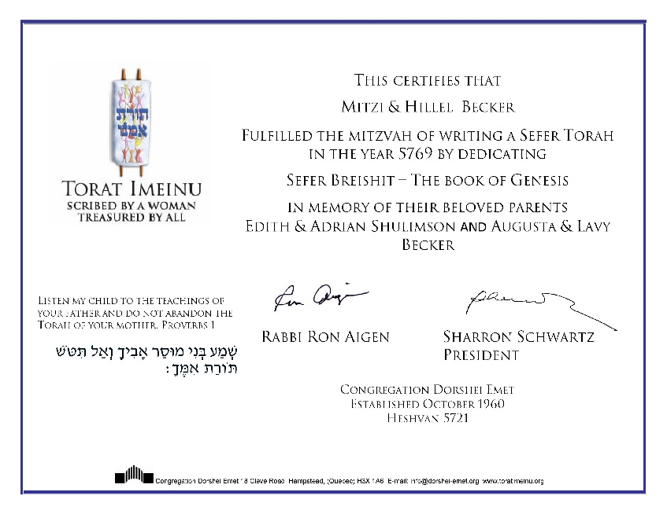
Marketing: Phase 1
Marketing was our first priority as this committee developed
The official name
Logo
Donation contracts
Certificates
Brochure
Letterhead
The dedication booklet
Donation cards (Passover, Rosh Hashanah)
web site
Most of this was done prior to unveiling the project to the synagogue board or membership

Slide 9
Year 2—Execution
The programming for our jubilee year included many events relating to Torat Imeinu. Some of the events included:
The Opening Launch on May 24, 2009
Two hands on a quill (several times throughout the year)
Kol Isha art exhibit at the Emet Gallery
Guest speakers on relevant topics
Calligraphy classes with our soferet
A Shabbat weekend with our soferet; Torat Imeinu Weekend
oneg shabbat
youth and pbm group
media
parlor meetings
Celebration on delivery of our Torah

Slide 11
The Web Page was “Project Central”
We developed a transactional website for the project. It was hosted with the main website, but had a discreet URL, separate branding, and a separate developer and maintenance service.
The website functioned as project central with all the static information about the project, plus a scrolling donor list updated weekly, a photo album from all the events, a media corner with links to all the TV, Radio, and Print publicity we garnered, and the classic donation thermometer updated weekly.
The website was also a great fundraising tool, giving us instant credibility & answered many questions (FAQ’s)

Slide 12
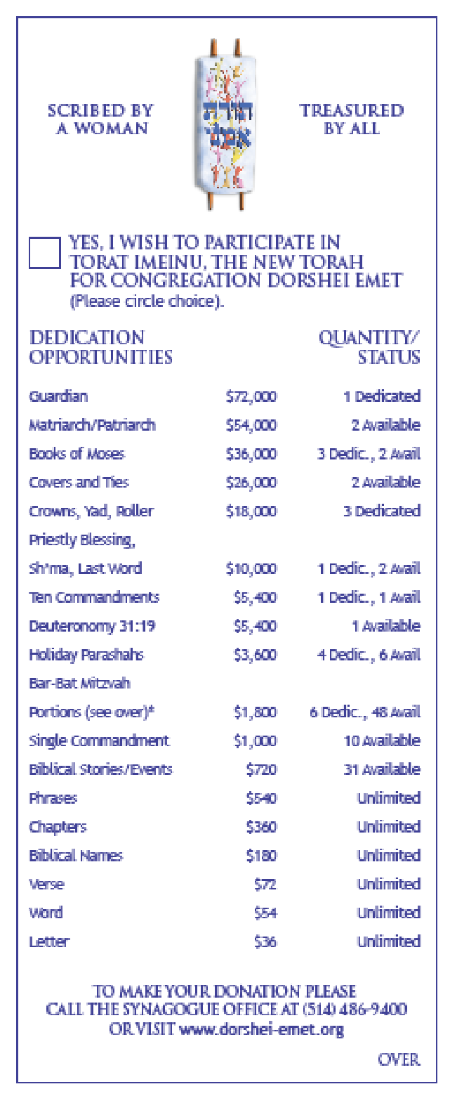
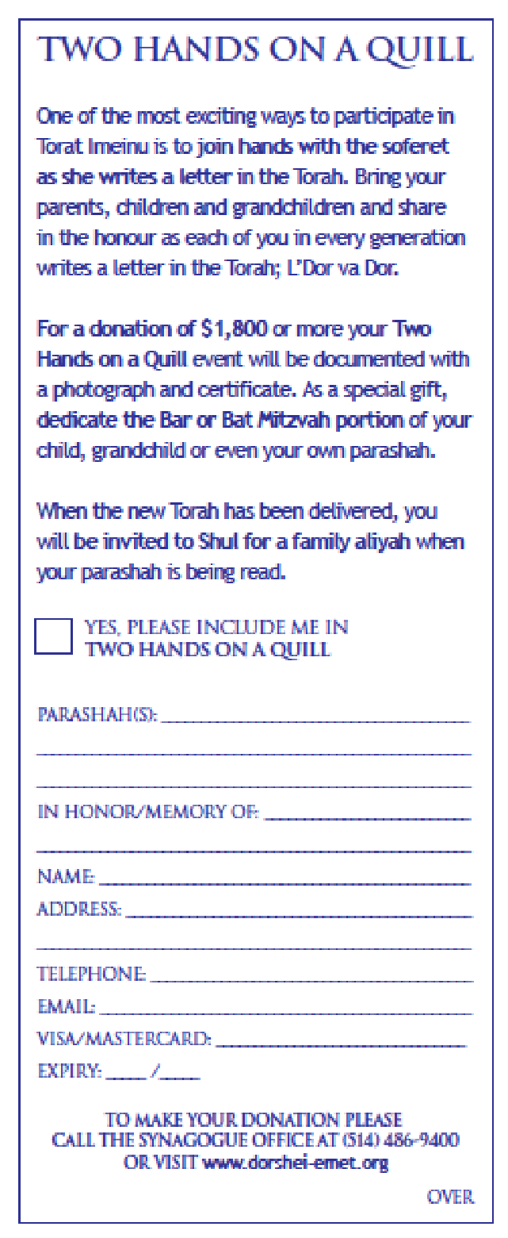

Slide 13
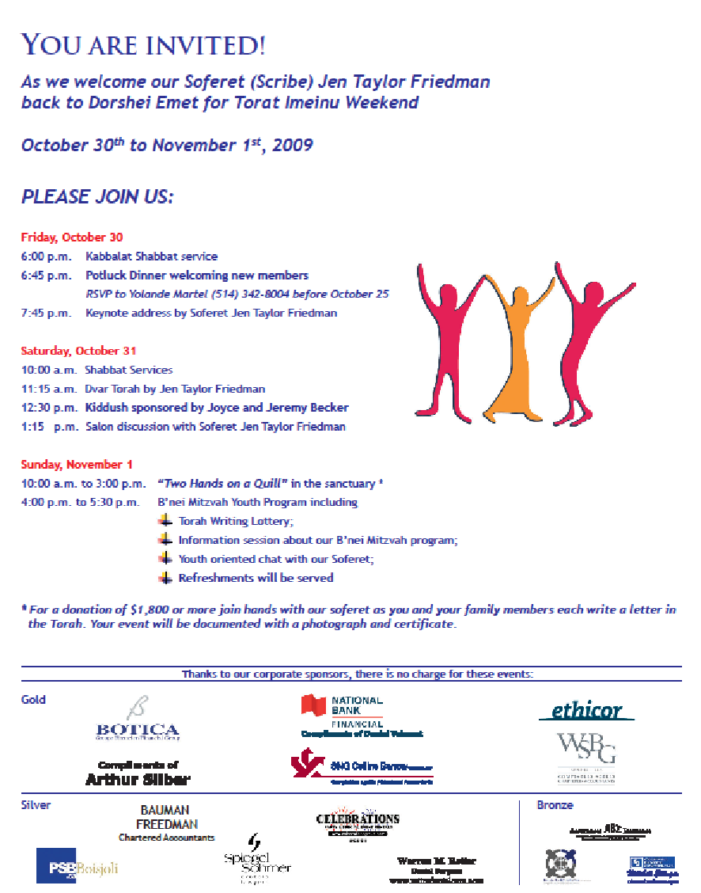

Slide 14
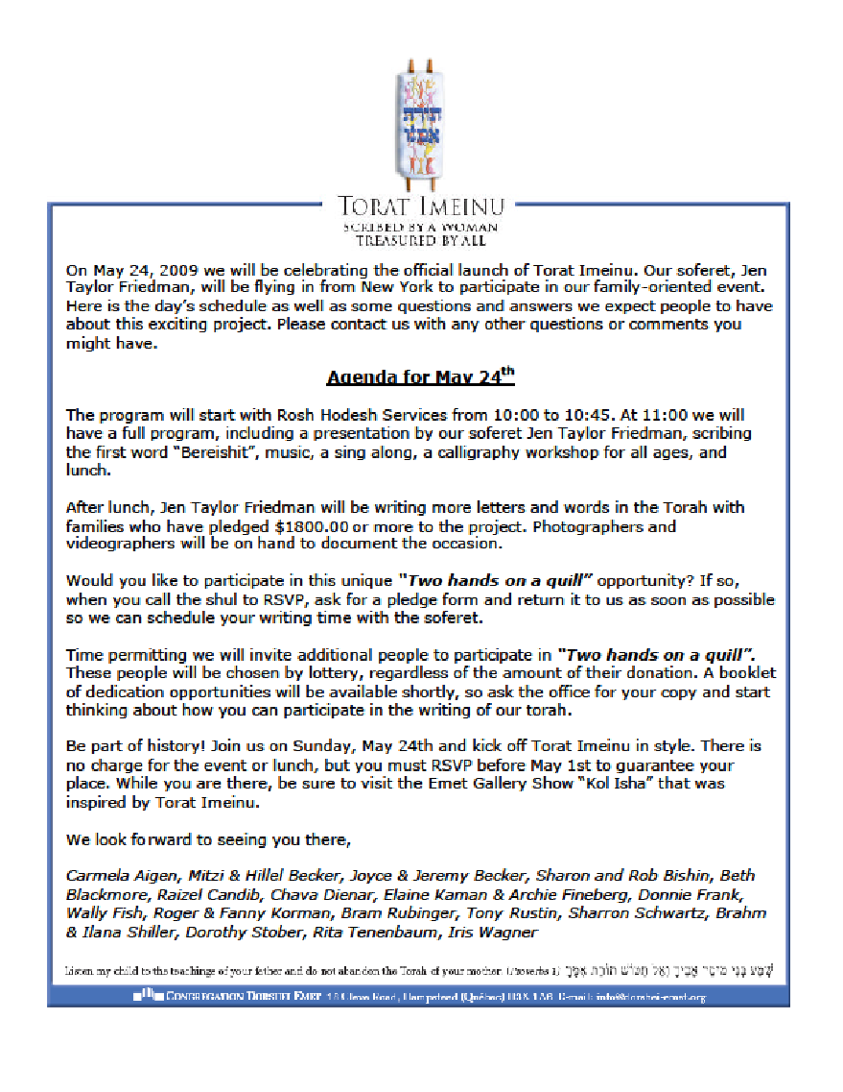

Slide 15
Corporate Sponsorships
Warren M. Retter
Dental Surgeon
www.retterdentalcare.com
compliments of
Arthur Silber
Bauman Freedman
Chartered Accountants
Party Time Rentals
Mitchell Ettinger
Chartered Real Estate Agent
Larry Zoltak, insurance

Slide 16
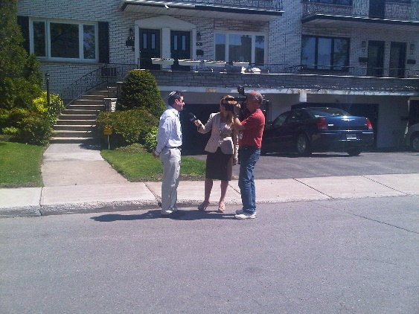
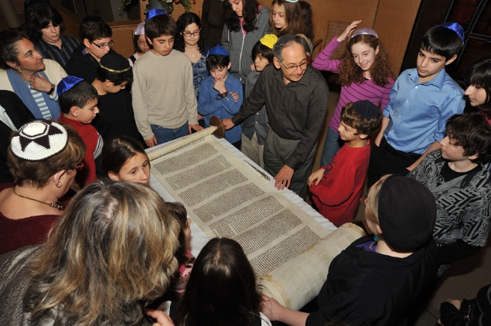
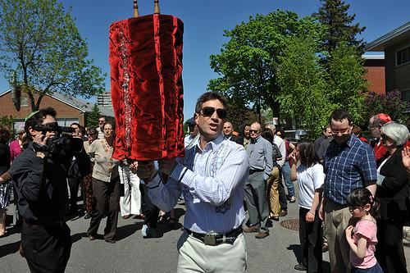
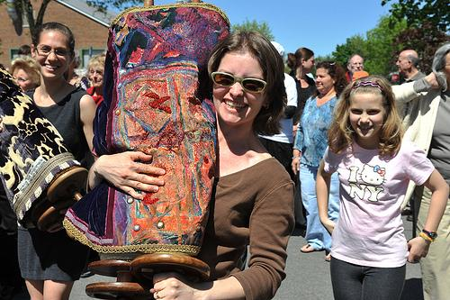
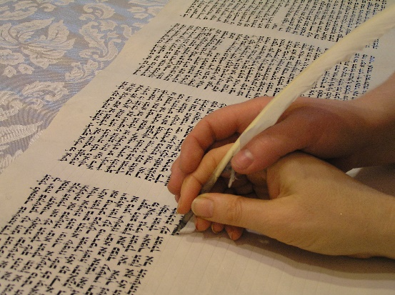
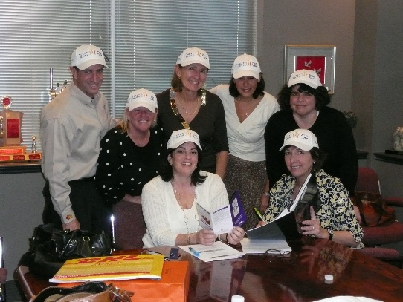
Year 2—Execution

Slide 17
Results
The fundraiser brought in $630,000 from within the congregation and the greater community ($17,000 above the goal)
Great coverage in the Canadian Jewish News, CTV Montreal, and other local Jewish and secular news sources
Drew participation from members outside the community
Acquired a new Torah for our congregation
Rejuvenated our members while offering every family the opportunity to participate regardless of dollar level
Raised our profile in the wider community
Eliminated our debt
Seeded a segregated endowment that started at 250K and is now over 380K and growing with new contributions and market returns
Of the $27,000 spent to execute the project, $12,000 was raised from non-member corporate sponsorships, netting a 2.4% cost of raising funds

Slide 18
What Worked Well (and What We Missed)
Importance of a strong website and marketing
Having a power couple lead the project
Free events (with food)
Pre selling volunteers to take on the project
Have one contact person (team)
Doing 99.9% of the work offsite without taxing the shul admin
Downplaying the $$ and hyping the emotion
Wish we had done a “Break-the-Bank” party for our youth
Parlor meetings were not fruitful in bringing in funding

