Slide 1
Can you hear me now?
How do we market our best selves?
Rachael Burgess, Advancement Officer
Reconstructing Judaism
May 8, 2018

Slide 2
Agenda for tonight
Introductions
Plan for the next sessions
Getting the most from our meetings
How do we make a message?
Homework

Slide 3
Introductions
Name
Community or congregation
Where is your community
What are you hoping to learn during these sessions?
One word to describe your community

Slide 4
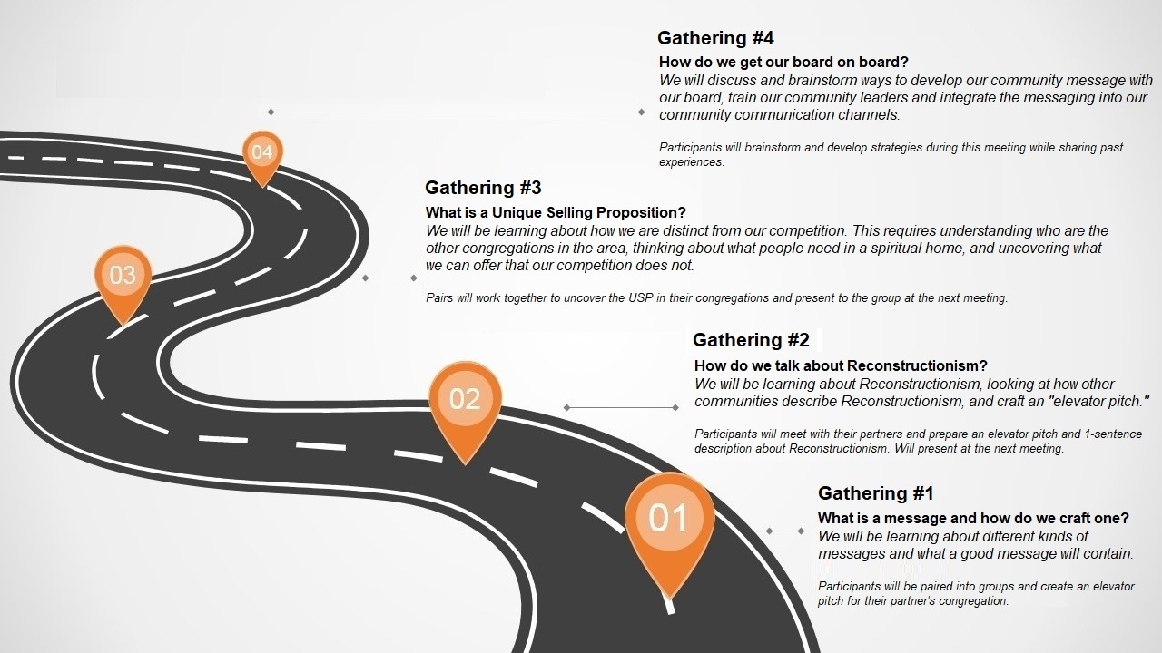
Plan for the next sessions

Slide 5
Getting the most from our meetings
This is a safe space. Please try to participate in our meetings. No ideas are stupid ideas here.
You will receive a survey tomorrow. If you can please fill this out prior to Shabbat.
Based on our info here, I will assign you to a partner with similar congregations but are not near each other. Please try to talk to each other in between meetings. Get to know each other.
There will be homework at the end of our sessions. Please participate.
I will be sending you some food for thought. You are also encouraged to research a bit on your own. If you find something interesting—a quote, an article, an infographic, a book, ect.—please share!

Slide 6
What is a message?
Audience
Assumption: Prospective Member
Message
Channel
?
Assumption: You

Slide 7
What is a message?
Someone learns about you from a credible source
(advertising, news articles, WOM)
Awareness
Person is aware of your organization and does further research (visits website, google searches)
Interest
Person decides if your organization meets their wants and needs.
Evaluation
Tries your organization on an experimental basis.
Trial
Joins and rejoins your organization
Adoption
Public Relations Strategies and Tactics; Wilcox, Cameron, and Reber

Slide 8
What is a message?
Has a goal behind it:
Know (knowledge, facts)
Believe (credibility, not as concrete as fact)
Feel (emotions)
Do (call to action)
Trying to solve a problem

Slide 9
What are the goals?
https://www.agudasachimma.org/

Slide 10
What are the goals?
CBH Mission
Inspired by the chutzpah of our founders, CBH’s mission is to promote a bold and expansive Jewish identity and culture emphasizing inclusivity, creativity, spirituality and social justice as we uphold our commitment to serve the LGBTQ and allied community.
https://www.congregationbethaverim.org/

Slide 12
What is an “Elevator Pitch”
A description of your organization and mission that can be spoken in less than 30 seconds. (60 words or less)

Slide 13
Reconstructing Judaism’s “Elevator Pitch”
Reconstructing Judaism is the central organization of the Reconstructionist movement. We train the next generation of rabbis, support and uplift congregations and havurot, foster emerging expressions of Jewish life, and encourage people to be their best selves — always helping to shape what it means to be Jewish today and to imagine the Jewish future.
(54 words if you are counting)

Slide 14
What’s next?
You will receive a survey tomorrow from me or Shosh. Please fill out the survey prior to Shabbat if possible.
You will be assigned a partner. Please be in touch with each other between sessions. Get to know each other.
You and your partner will write elevator pitches on the other’s community (60 words or less). You will present these to the group.

Slide 15
Resources
Connect to each other
Post a question to our Facebook group: www.facebook.com/groups/canyouhearmenowRLN/
Email or call Rachael Burgess
(rburgess@reconstructingjudaism.org or 215.576.0800; ext. 141)

