Slide 1
What is the “Dual Narrative” Approach to Teaching the Israeli-Palestinian Conflict?
Session 3
Rabbi Maurice Harris

Slide 2
Today’s Session in a Nutshell
Opening: Two opening prayers from two different sources, and review of goals.
What brought you here? (2 people share)
Your thoughts on the reading
Safety & Risk: Structural Choices for Planning Dual-Narrative Events
Problem with Dual-Narrative: Power dynamics can be obscured.

Slide 3
Opening Kavannah 1
Tefilat HaDerekh
By Rabbi David Seidenberg (adapted text)
May the holy desire come from You, Eternal One, our Source and our ancestors' Source, that You will lead us toward peace and make our every step be a step toward peace and our path be a path of peace. May You help us reach the true target of our desire: life, joy, and peace. Rescue us from all enmity and ambush and theft and predation, from all impulses to harm that confront us on this path, and from any dangerous complications that may arise from the passions that come into the world. Bless our actions and handiwork and grant us grace, love, and compassion in Your eyes and in the eyes of all who behold us, for You are the one who is listening to hear the prayer of every mouth of every creature. Blessed be You who listens for prayer.
https://ritualwell.org/ritual/tefilat-haderekh

Slide 4
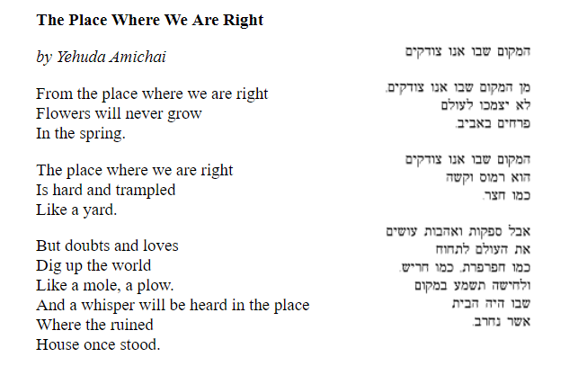
Opening Kavannah 2
https://daysofawe.net/shebotzodkim.htm

Slide 5
181- partition
194- refugees
273- admission with 194
242 & 338- land 4 peace

Slide 6
What kinds of programs are you interested in offering?

Slide 7
Political Moral Spiritual Practical Hopeful

Slide 8
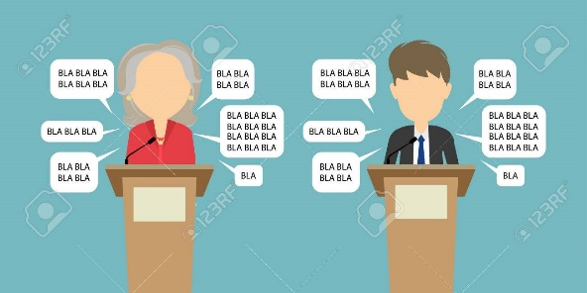
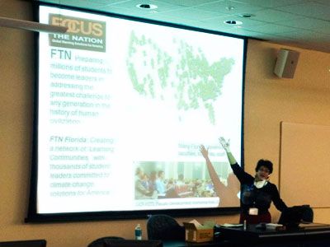
For events in a shul
Strong boundaries around the event create the opportunity for people to engage the fire without getting too burned
For a series of events, begin with high-safety / low risk and take incrementally bigger risks as trust builds

Slide 9
For events in a shul
1. Advanced registrations plus sign-off on civility covenant
2. To complete registration, must respond to a few questions (see sample registration questions below)
3. Opening / closing ritual moment

Slide 10
Code of Civility
Respectful disagreement
Respectful questioning
For people who tend to like to share a lot, making sure that you leave room for others to participate
Refraining from language that is bigoted or derogatory
Assuming the best intentions, not the worst, if someone does say something that causes pain or offense (“ouch”)

Slide 11
Code of Civility
Allowing the use of politicized language while holding one another to a mutually agreed expectation to avoid bigoted or derogatory language. (This can be tricky.)
This is a closed course – no visitors or guests without the advance permission of the instructor.

Slide 12
Registration questions?
In order to help the facilitator create a constructive learning environment for everyone, please respond to the following questions. Your responses will not be shared with anyone else in the class.
What hopes do you bring to this class?
What concerns or worries do you bring to this class?
What, if anything, do you want to know about the instructor?
Please tell us a little about your experiences and perspectives on this subject?

Slide 13
For interfaith or public events
1. Greeters hand out civility pledge notecards.
2. Best events aren’t debates – they include speakers who give voice to both narratives, which can happen in various ways.
3. Scripted and mutually previewed & approved opening / closing ritual moment by clergy of multiple faiths.
4. Questions to the speakers must be written on notecards and handed to volunteers.
5. Publicity choices matter.

Slide 14
Facilitator self-identification
I’m a “progressive rabbi” with ties to the Israeli peace movement.
I have close family in Israel and partly grew up there.
I’ve formed important friendships with Palestinians living in the West Bank and have come to care deeply about them.
So on a gut level, Israel feels like family to me, and Palestinians feel like people I have deep feelings for. I respect, admire, and get frustrated by them both.

Slide 15
Things that can go wrong
1. There are groups that oppose any program based on a dual narrative approach, and some of them believe that it is their duty to redirect the discussion to their objection to the assumptions upon which the event is based.
2. Grandstanding & individuals taking up too much airspace
3. Getting stuck over language and terminology
4. Getting blindsided in public

Slide 16
Suggestions
Your Advice / Suggestions:

Slide 17
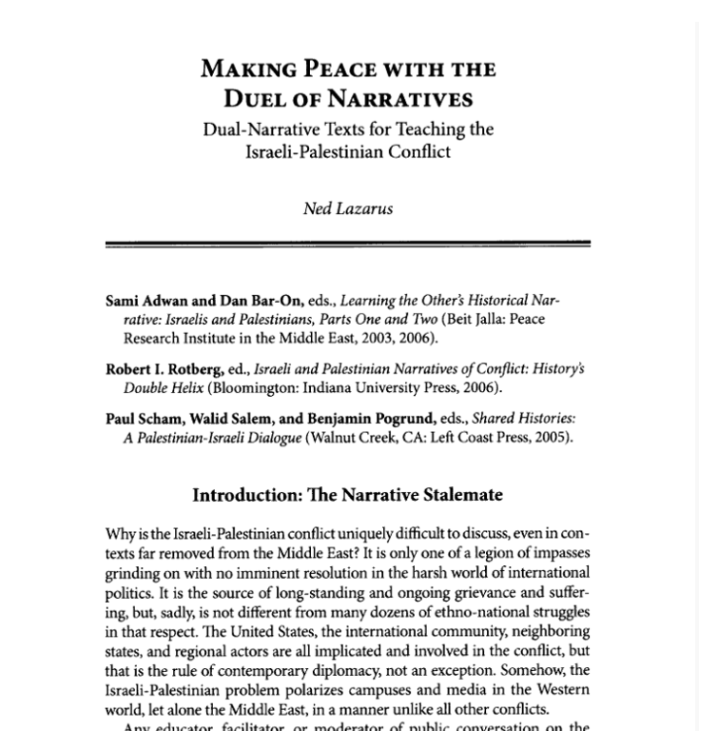
Next Steps…
Please read the PDF you’ll receive with a short portion of this journal article by Ned Lazarus.
If you have questions or thoughts to share, please email them to Maurice at mharris@rrc.edu and he’ll weave them into our next session.

