Slide 1
What is the “Dual Narrative” Approach to Teaching the Israeli-Palestinian Conflict?
Session 4
Rabbi Maurice Harris

Slide 2
Today’s Session in a Nutshell
Maps, Narrative, and how a dual narrative approach serves a tool for asking good questions in the presence of maps.
De-familiarize something familiar – something not emotionally charged.
Use vivid examples that cause the group to exercise the thought muscles of multiple narratives.
Identify the partial truths present in each example.
Suggest one of the goals as people feeling more conflicted and confused than when they arrived.

Slide 3
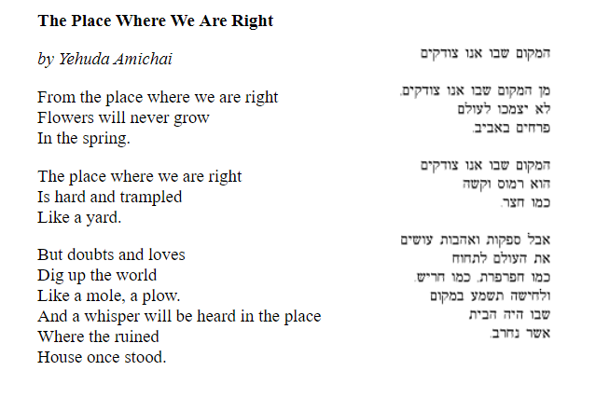
Opening Kavannah 1
https://daysofawe.net/shebotzodkim.htm

Slide 4
Maps of the World

Slide 5
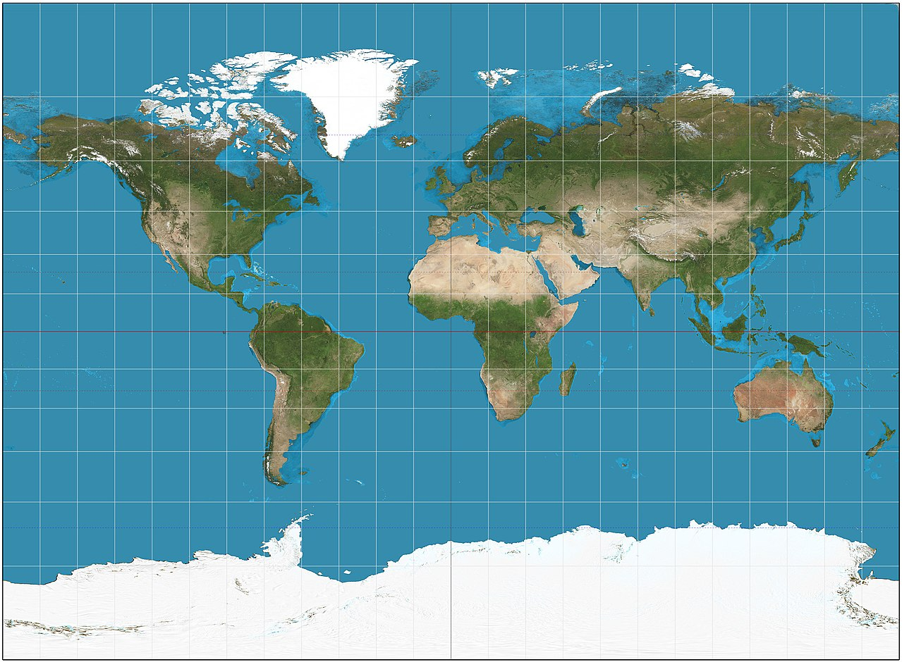
Projection 1
By Strebe - Own work, CC BY-SA 3.0, https://commons.wikimedia.org/w/index.php?curid=16115310

Slide 6
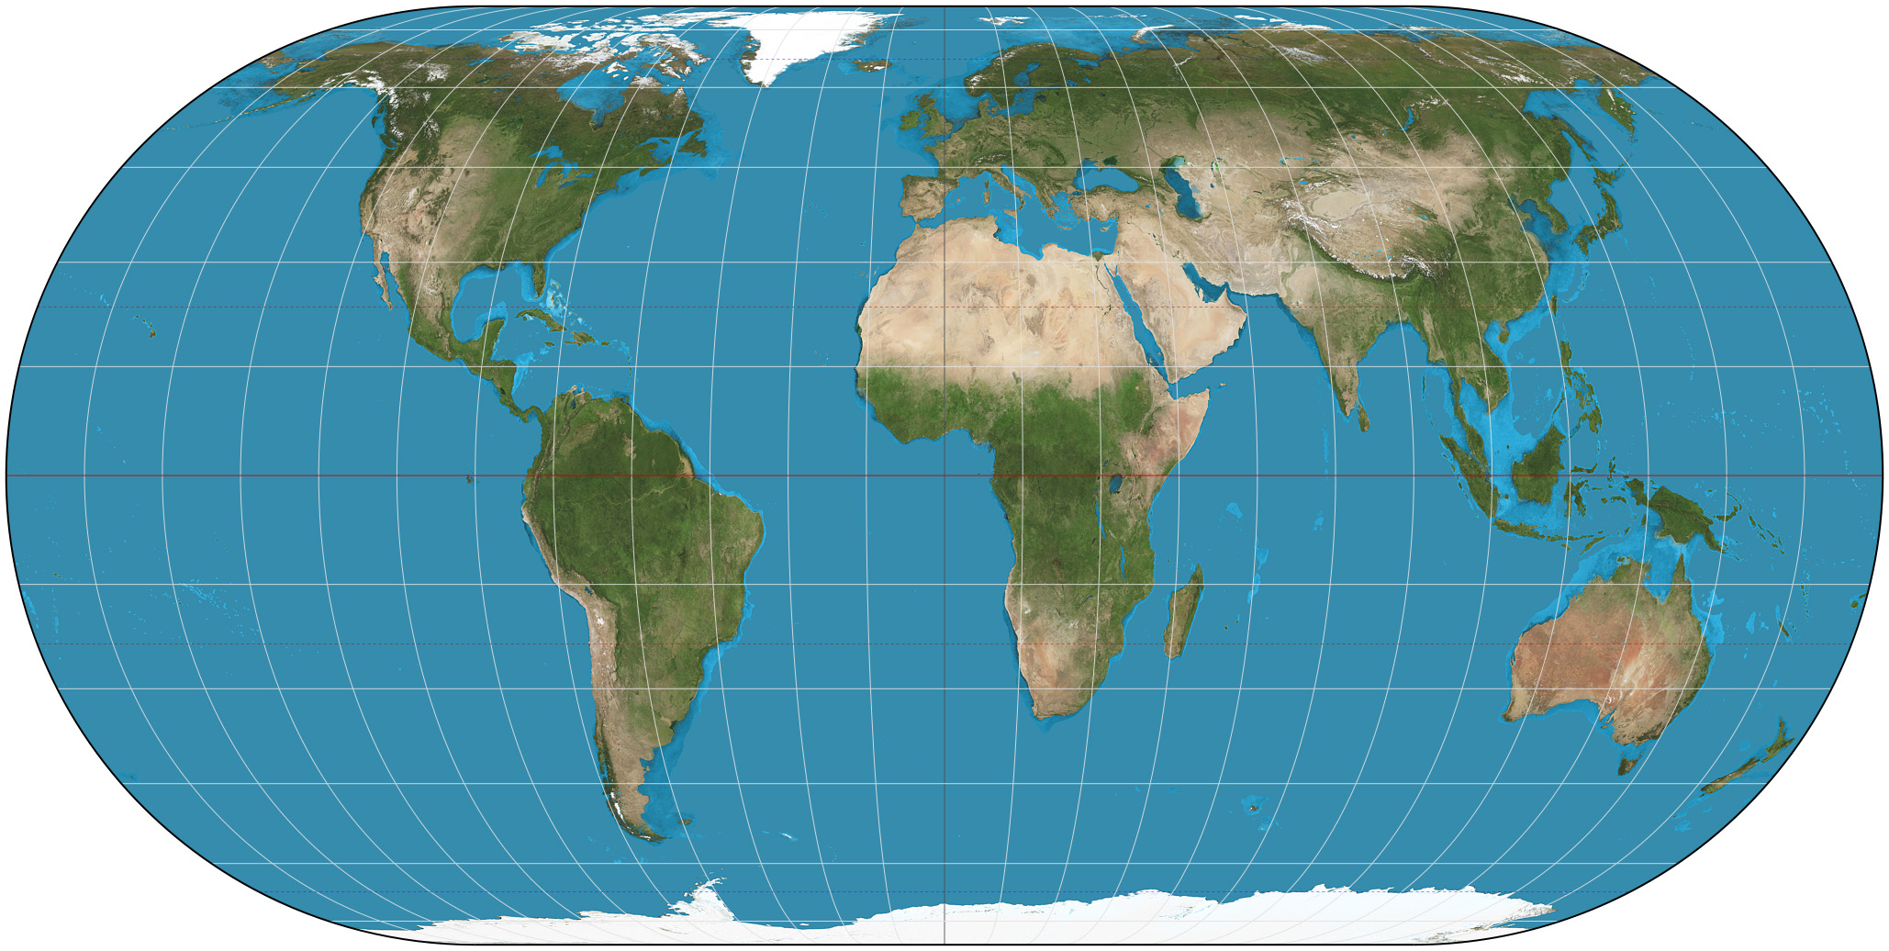
Projection 2
By Strebe - Own work, CC BY-SA 3.0,
https://commons.wikimedia.org/w/index.php?curid=16115201

Slide 7
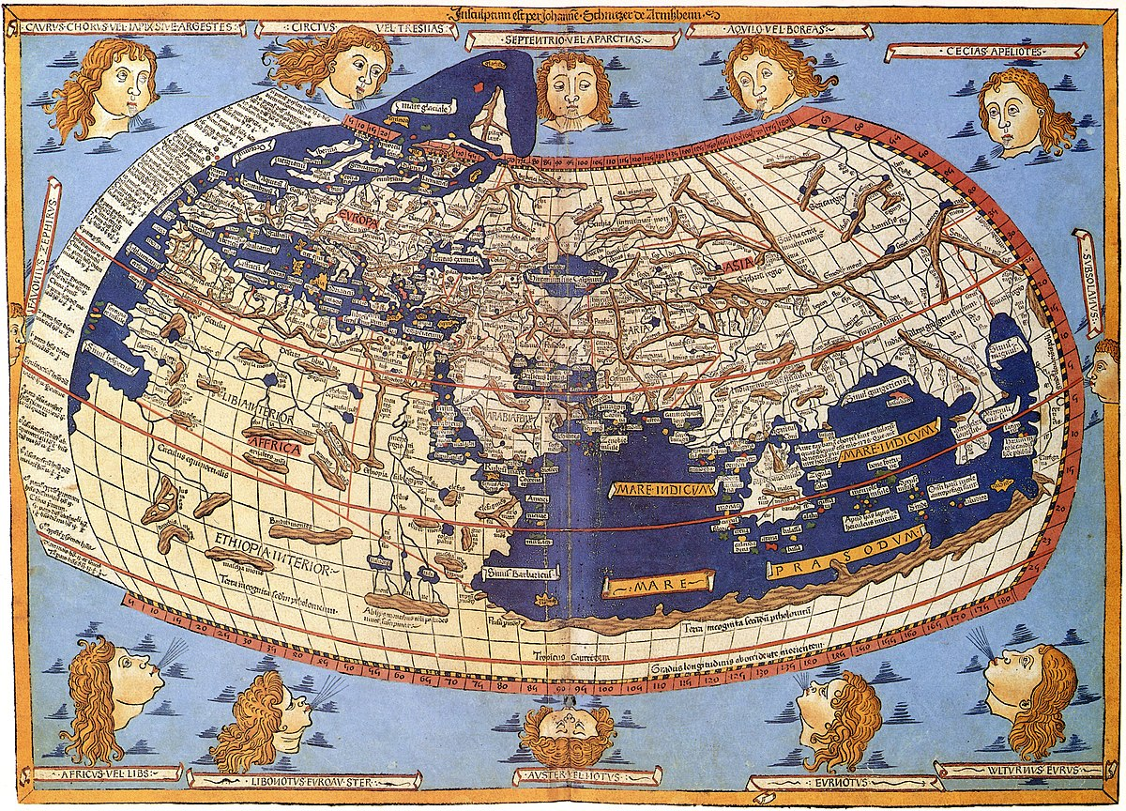
Projection 3
Notes:
Sometimes we’re limited by what we’re unaware of.

Slide 8
Maps of the USA

Slide 9
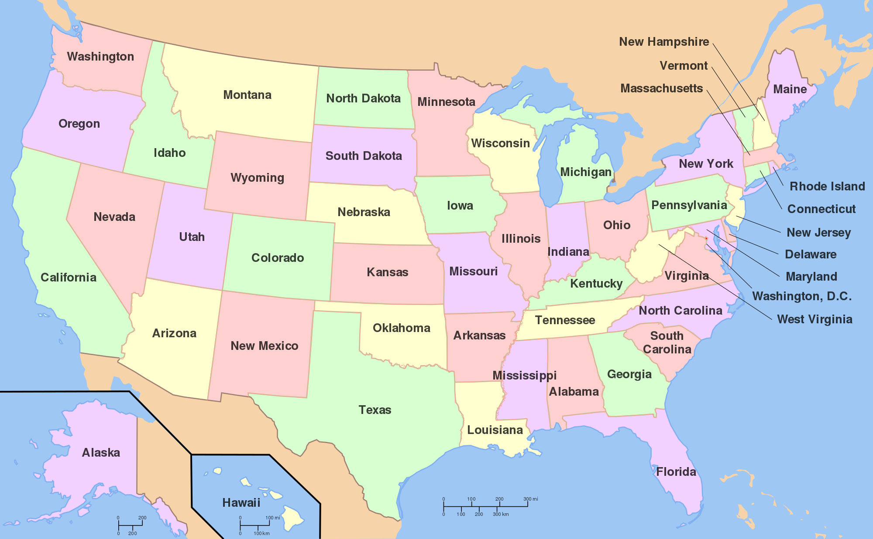
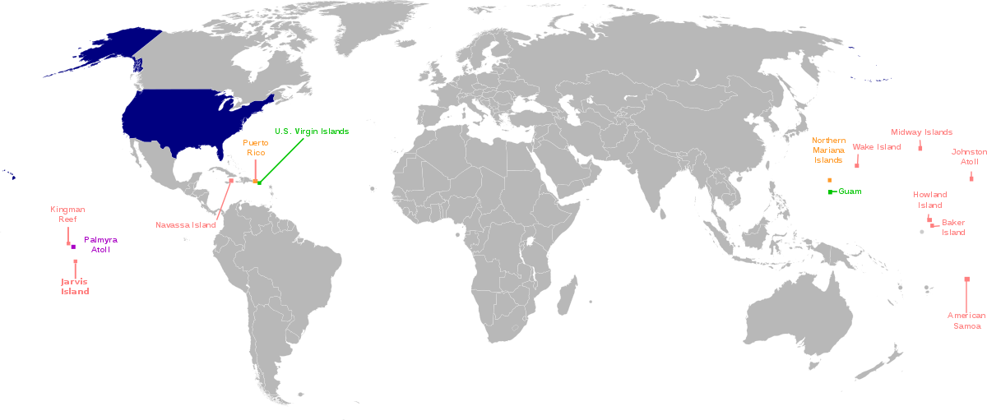
Projection 1
Notes:
Sometimes we’re limited by what we’re unaware of.

Slide 10
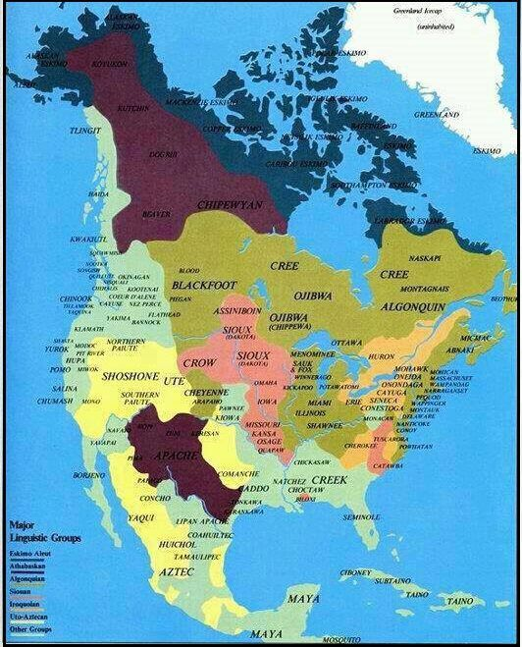
Projection 2
Notes:
Sometimes we’re limited by what we’re unaware of.

Slide 11
Projection 3
Notes:
Is a map supposed to tell us about land primarily, or about population centers? What do we know about sparsely populated areas? Are these places the same as other kinds of places?

Slide 12
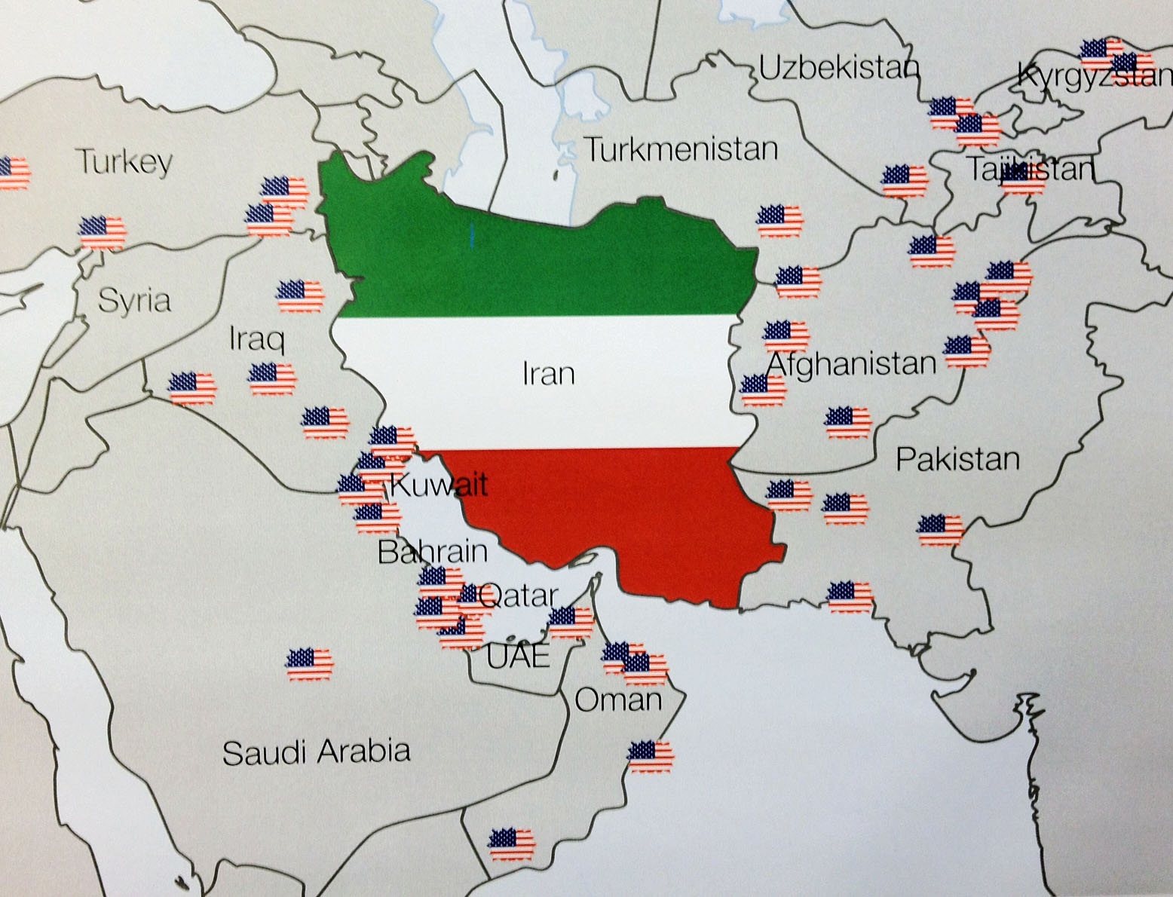
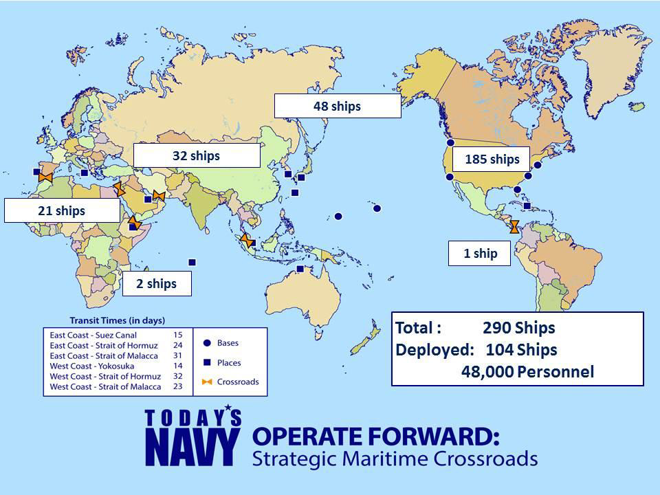
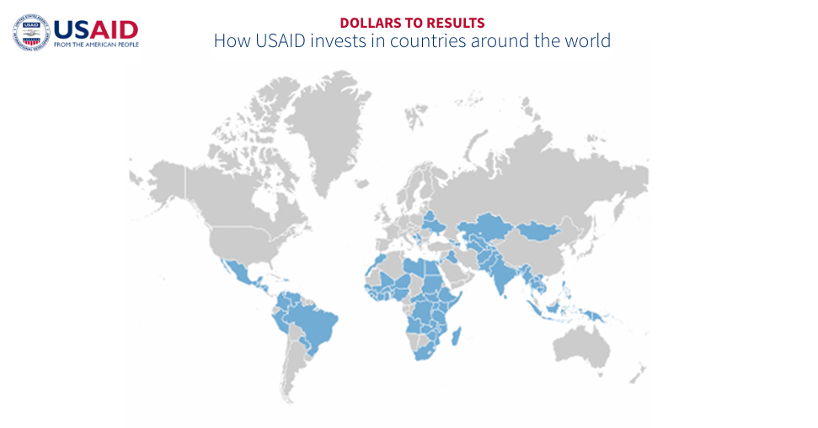
Projection 4
Notes:
Sometimes we’re limited by what we’re unaware of.

Slide 13
Maps of Zionist narratives

Slide 14
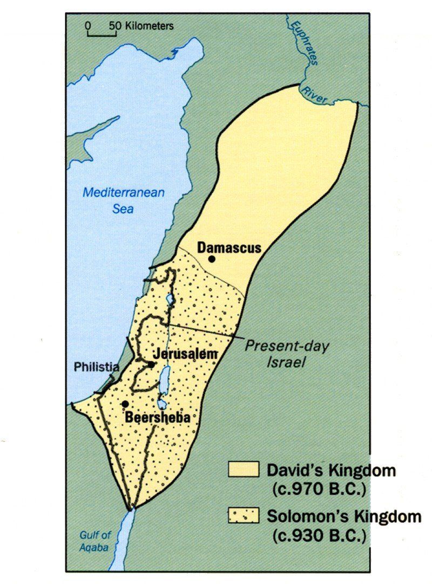
Projection 1
Notes:
Sometimes we’re limited by what we’re unaware of.

Slide 15
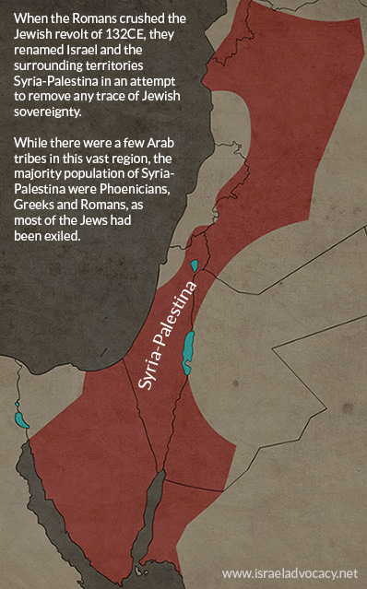
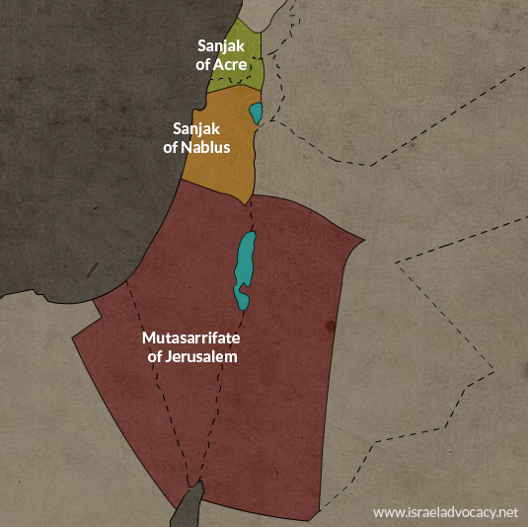
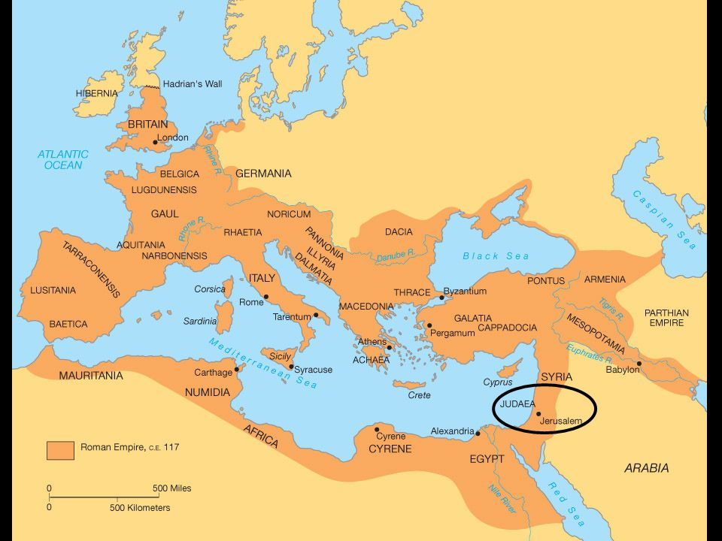
Projection 2
Roman Empire circa 100 CE
Notes:
Sometimes we’re limited by what we’re unaware of.

Slide 16
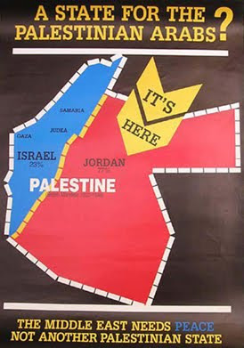
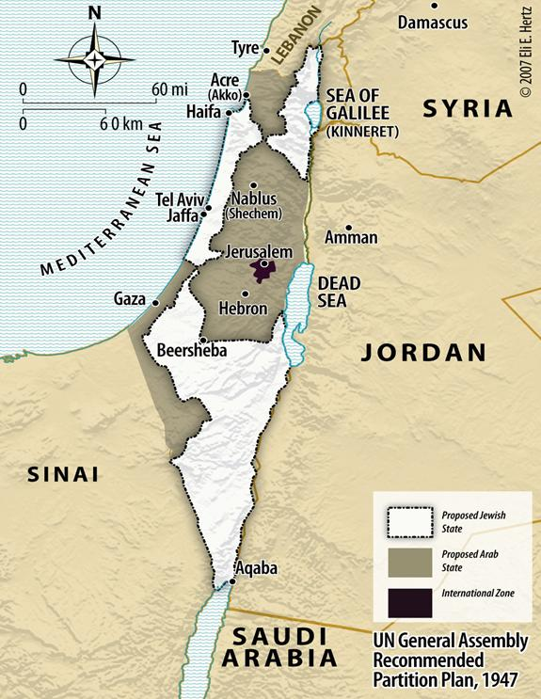
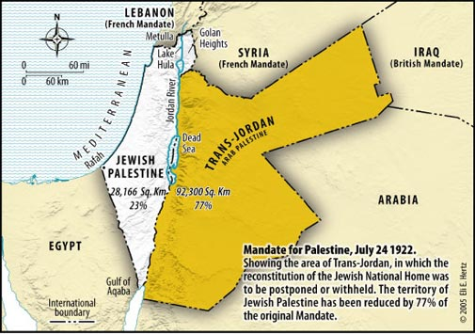
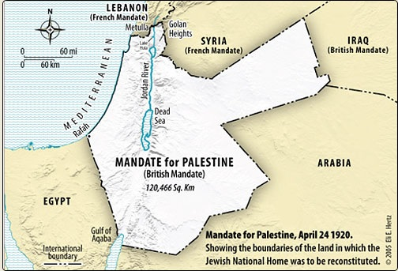
Projection 3
Notes:
Sometimes we’re limited by what we’re unaware of.

Slide 17
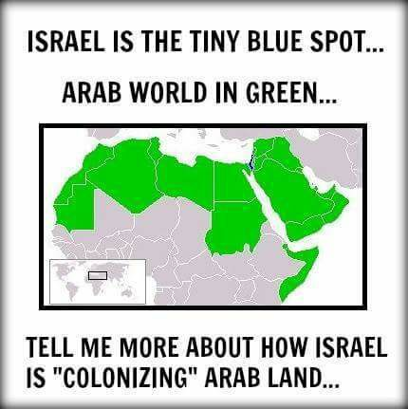
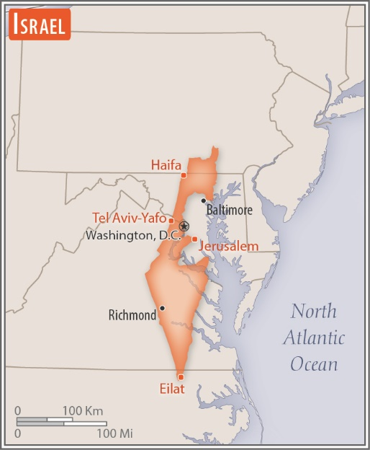
Projection 4
Notes:
Sometimes we’re limited by what we’re unaware of.

Slide 18
Projection 5
Tel Aviv
West
Cairo
Bank
Gaza
Notes:
Sometimes we’re limited by what we’re unaware of.

Slide 19
Maps of Palestinian narratives

Slide 20
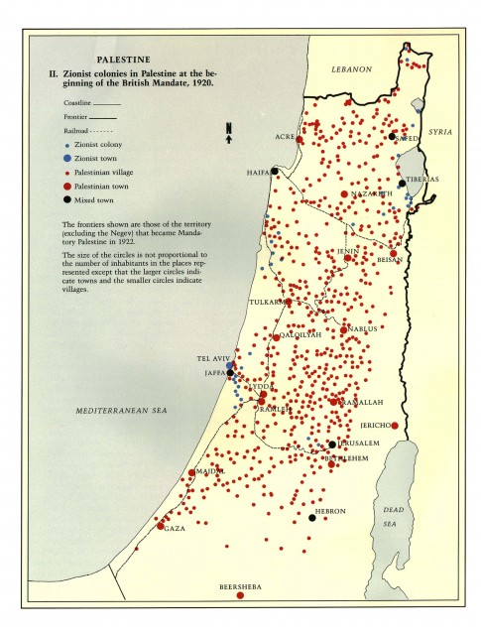
Projection 1
Notes:
Sometimes we’re limited by what we’re unaware of.

Slide 21
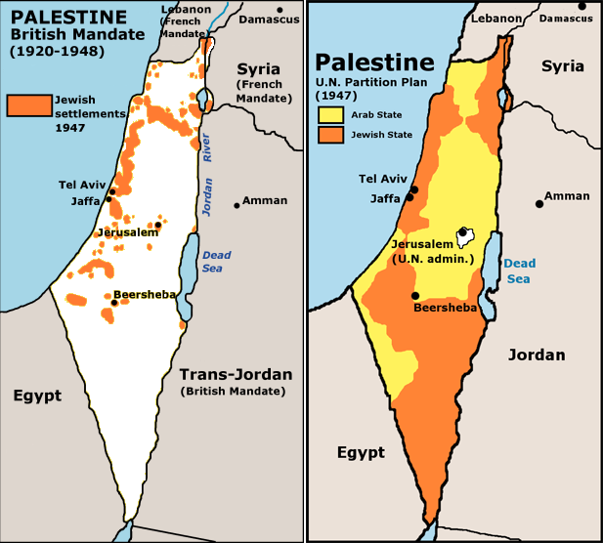
Projection 2
Notes:
Sometimes we’re limited by what we’re unaware of.

Slide 22
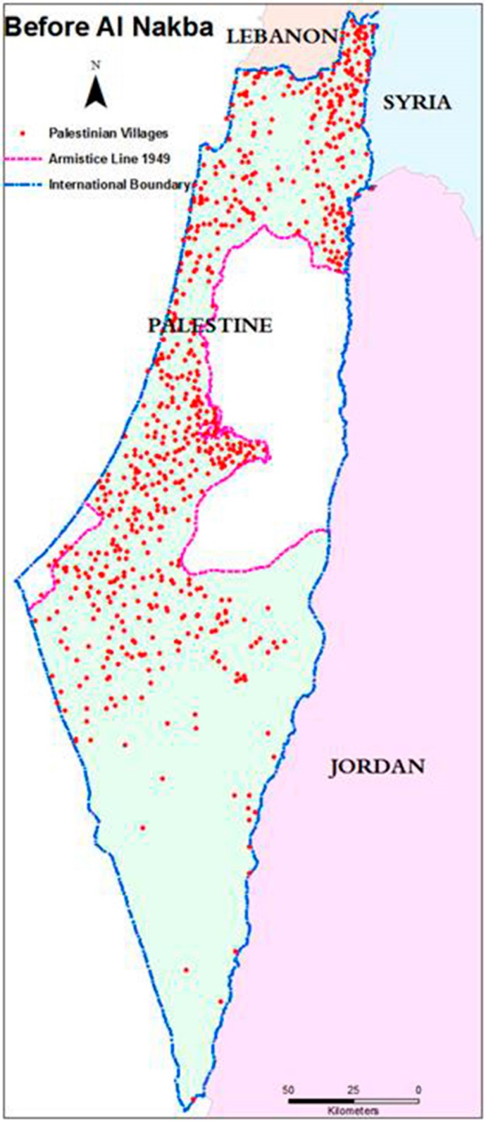
Projection 3
Notes:
Sometimes we’re limited by what we’re unaware of.

Slide 23
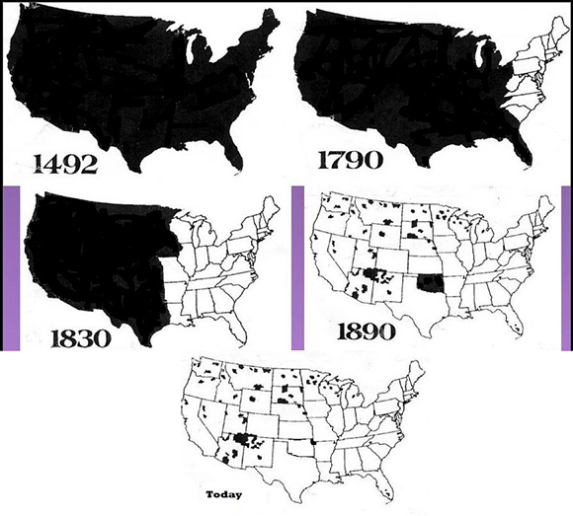
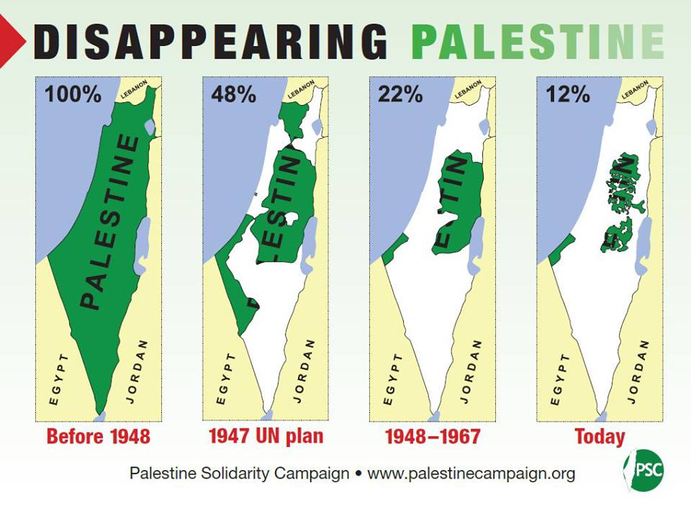
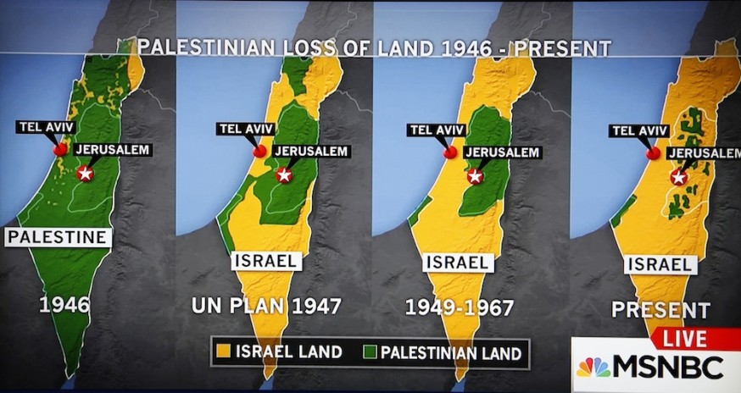
Projection 4
Notes:
Sometimes we’re limited by what we’re unaware of.

Slide 24
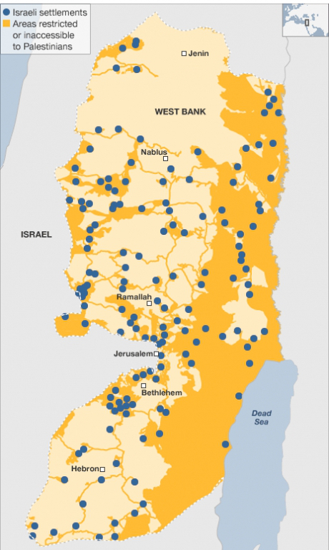
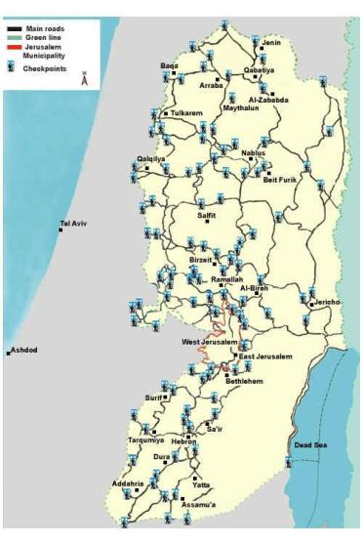
Projection 5
Notes:
Sometimes we’re limited by what we’re unaware of.

Slide 25
Faces

Slide 26
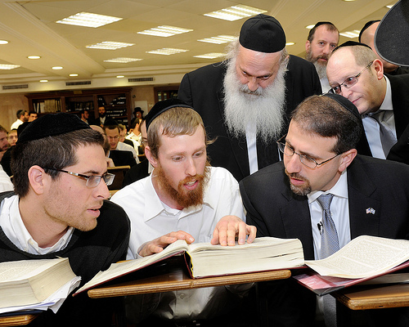
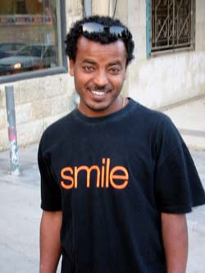
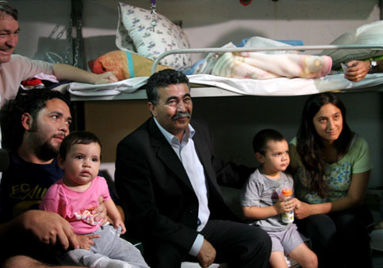
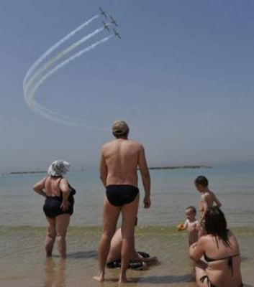
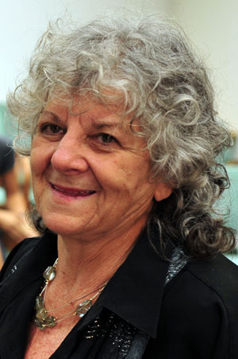
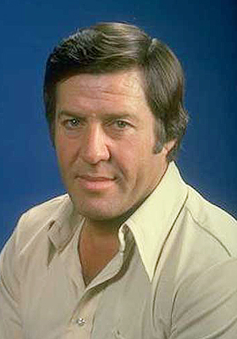

Slide 27
