Slide 1
ANNUAL CAMPAIGN
Fund Development Learning Network
January 31, 2018

Slide 2
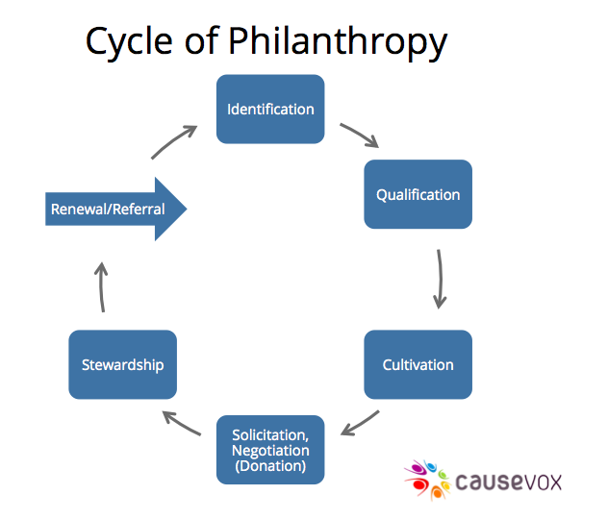
Cycle of Giving

Slide 3
Key Fundraising Principles
Best practice fundraising is:
Relational not transactional
Donor centered NOT synagogue centered
Tied to congregational vision
Transformational in nature
Demonstrates strong impact

Slide 4
Who Is Involved?
Clergy
Officers/Board
Congregants
Youth

Slide 5
Menu
Create a Menu of Meaningful Annual Giving Opportunities
Breakdown your annual budget into fundable giving opportunities
Current programs
Build in overhead – 15%
Build in staff
New/Innovative programs
Building Reserve
Life and Legacy
Other

Slide 6
Strategies
High Holiday Appeals
Donor Directed Funds
Annual Appeal Letters
Personal Solicitations
Award Dinners/Galas
One Off Events
Sponsorships
Rabbis Circle/Presidents Circle – Major Donors Program
Corporate Sponsorship
Foundations

Slide 7
Big Ideas
Round Table Discussion

Slide 8
Communication
Be in Touch/Stay in Touch
Use All Mediums
In Person Meetings
Phone Calls
Emails
Social Media
Traditional Media
What Works
Interesting Articles
Personal Testimonies and Stories
Emotion
Facts and Figures
Volunteer Opportunities and Engagement
Answer All Questions
Start Donor Groups

Slide 9
Communication
Personal Thank You Letters – Keep notes on folks to incorporate into regular correspondence
Personal Emails from Leadership
Public Acknowledgment (within synagogue and within community)
Social Media
Press
Send Reports, Annual Reports, Graphs, Impact Statements, Personal Testimonies, Project Updates
Video and Podcasts

Slide 10
Communication
Website
Parlor Meetings/Non-Ask Events
Face-to-Face Meetings with Clergy and Board President
Meeting with Beneficiaries
Acknowledge Anniversaries, Birthdays, Other Important Life Cycle Events
Schedule Reminders for Yourself to Contact Donors Regularly
Appreciation Events

Slide 11
Call to Action
Get them involved
Committees
Event Planning
Volunteer Opportunities
Board Engagement
Ask them what they think
What could “agency” be doing better?
Donor Roundtables
Resolve Donor Complaints Immediately
Ask them to open their networks and create introductions

