Slide 1
Growth and Development
Gathering 3
March 28, 2019
Deb Friedman
Guests:
Cyd Weissman and Rabbi Shelly Barnathan
Deb

Slide 2
Where we have been & where we are going

Slide 3
Engaging New Members---Shifting perspective
A new breed of religious leaders will need to re-engineer their
skill sets, cultivate new communities and re-imagine
the sacred practices and spaces. But the consumers’ new-found
power that comes with curation,
personalization, and customization comes with a new level of responsibility
and accountability to assure that they understand the job to be done: building
community and helping people flourish. If these new products and services are
good enough to get the job done then disruption and, in many cases, a decimation of the
Religious incumbents will not be far behind. The incumbents must learn to disrupt themselves—
a very tall order—or be disrupted by a rabbi and priest in a garage.
https://bigthink.com/offwhite-papers/the-great-unbundling-will-organized-religion-go-the-same-way-as-cable-tv

Slide 4
Growth and Development: Engaging Potential Members and New Members
How engagement is most often created?

Slide 5
Growth and Development: Engaging Potential Members and New Members
Jobs to be done: https://strategyn.com/customer-centered-innovation-map/
Design Thinking: https://www.enterpriseirregulars.com/125085/what-is-design-thinking/
1. Shift from the committee needing to know the solutions---listen, empathize and solution emerges
2. Shift from planning the solution—to experimenting, & co-construct small tasks
3. Shift from the flyer --to social connectors 2 friends tell 2 friends

Slide 6
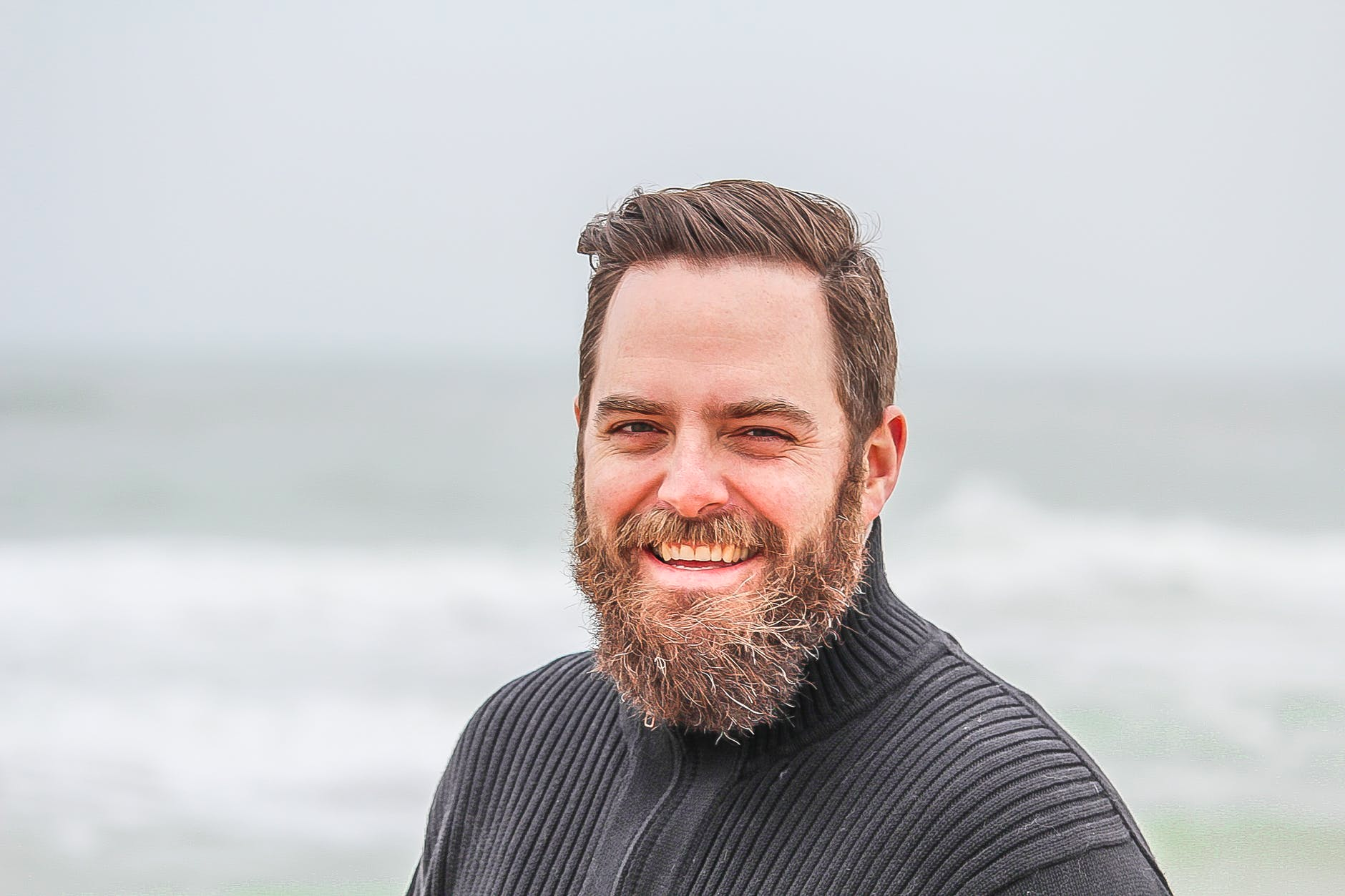
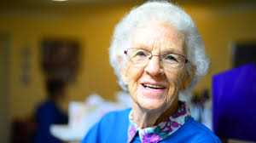
Growth and Development: Engaging Potential Members and New Members
Shift to empathy --insight
Tell me more:
about your life
about your hopes and dreams
what gets in the way, pains and gains

Slide 7
Growth and Development: Engaging Potential Members and New Members
Listen to stories
Can you tell me a story about a time
What was the best or worst part of the time/ an experience
Can you tell me about the first time you…what do you remember about that day
Be Open Be Curious
Ask Why, and then ask why again, going deeper into the story, revealing feelings and perceptions
Follow the strands, if you find something that matters to them, learn more
Focus on depth and ask: tell me more, what were you feeling, can you say more
Be Human
Affirm their perspectives and share your own (don’t over share)
Be honest—share your intention for the conversation that will help build the community
Be grateful—express your appreciation for what you hear and what you will do as follow up
Shift to empathy --insight
Tell me more:
about your life
about your hopes and dreams
what gets in the way, pains and gains

Slide 8
Shift to Empathy (based on material from Columbia Business School) Jobs, Pains & Gains
Jobs/Tasks: Listen for what the person is trying to do, whether it be physical ^{or emotional}
“Be a good parent—raise children in a wild ^{west world} ^{where Siri} ^{is} ^{part of the famliy.”}
Pains: By investigating the details of their process, you identify what challenges and the severity they experience while doing the job or accomplishing a task.
“We work all the time, tech, stress, no time for us for me, no ^{support.”}
^{Gains: Listen for} benefits and outcomes. What value will be derived from its use? Will functionality improve? Will it save money? Will the customer feel better? “Feel some relief that is not an add on, rather fits in to the rhythm of our lives, we’ll feel supported..”

Slide 9
Shift to, experiment, share small tasks, and 2 people tell 2 people
Shift from planning the solution—to experimenting, try, learn, try & co-construct small tasks
Shift from the flyer --to social connectors 2 friends tell 2 friends

Slide 10
Rabbi Shelly Barnathan-case study
Or Zarua
Engaging the Unengaged
Leading from empathy
Leading a co-constructed community

Slide 11
Process
Over a period of 7 months, I met with over 80 baby boomers/empty nesters for over 100 coffee conversations.
I met with individuals and small groups, and I asked key questions around values, hopes, and dreams for this “elder” time in their lives.
I called these “Holy Conversations”, always preceded by the Brachah, “…La’asok B’divrei Torah.”
Advice - Get yourselves a Starbucks or Panera’s card!

Slide 12
100+ Coffees - Holy Conversation Questions
If you belong or have belonged to a synagogue, what drew you originally to your synagogue?
Which values are of the most importance to you in the communities to which you choose to belong?
What are the pressing questions of deep, pertinent meaning for you in this phase of your life?
When and how do you feel that your deepest Neshama/soul, your deep authentic self, is accessed, nourished, and expressed?
What are your hopes and dreams for continuing to make deep, authentic meaning in your life?
What is the Torah/legacy that you hope to pass on to your children and grandchildren, and to the world?

Slide 13
5 Key Themes that emerged:
The desire to continue to know oneself deeply and to live authentically.
The desire to live lives guided by Jewish teachings and Jewish values.
The desire to move away from that which is materialistic and to live with deep integrity.
The desire to engage in meaningful Tikkun Olam work.
The desire to be known by others in a supportive, safe, relational Jewish community.
These themes informed the calendar of offerings for the 2017/18 Or Zarua year.

Slide 14
Questions-Next steps!

