Slide 1
How do network weavers have the greatest impact?
October 26, 2017
Our First Gathering

Slide 2
Getting to know each other Welcome
https://docs.google.com/document/d/18HA26wgkewyRdO5GI3EzIQ0E9XzqPLjEFFTcrHwod2A/edit

Slide 3
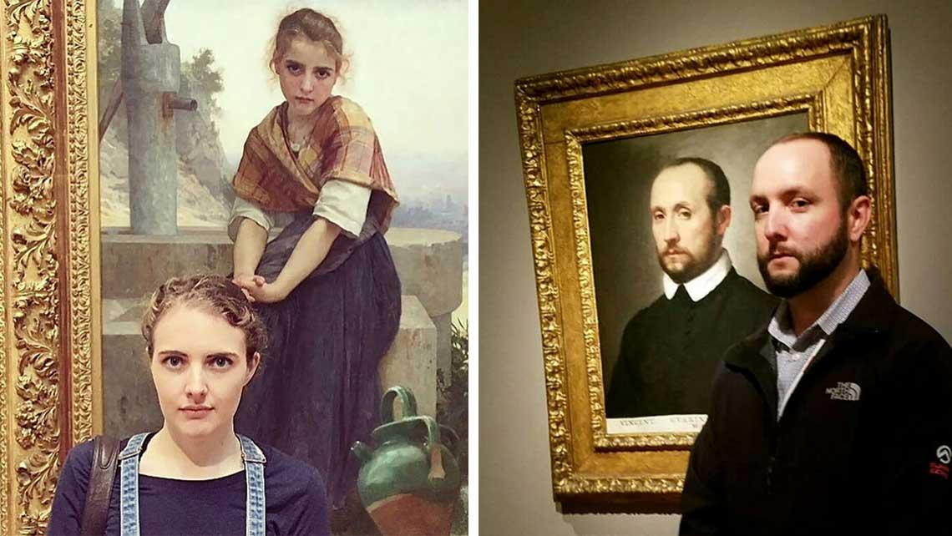
Emerging values
We share:
*A commitment to the vibrancy of Jewish life
*Roles that bring people together in common cause
*A belief that greater impact comes from learning from other’s wisdom and misses
*A willingness to shape a culture of generosity

Slide 4
Goals:
As Network leaders we will learn from one another’s practice and questions to increase our impact on network participants
To Document, Curate and Share our learning to improve our own learning and to share with others beyond this network

Slide 5
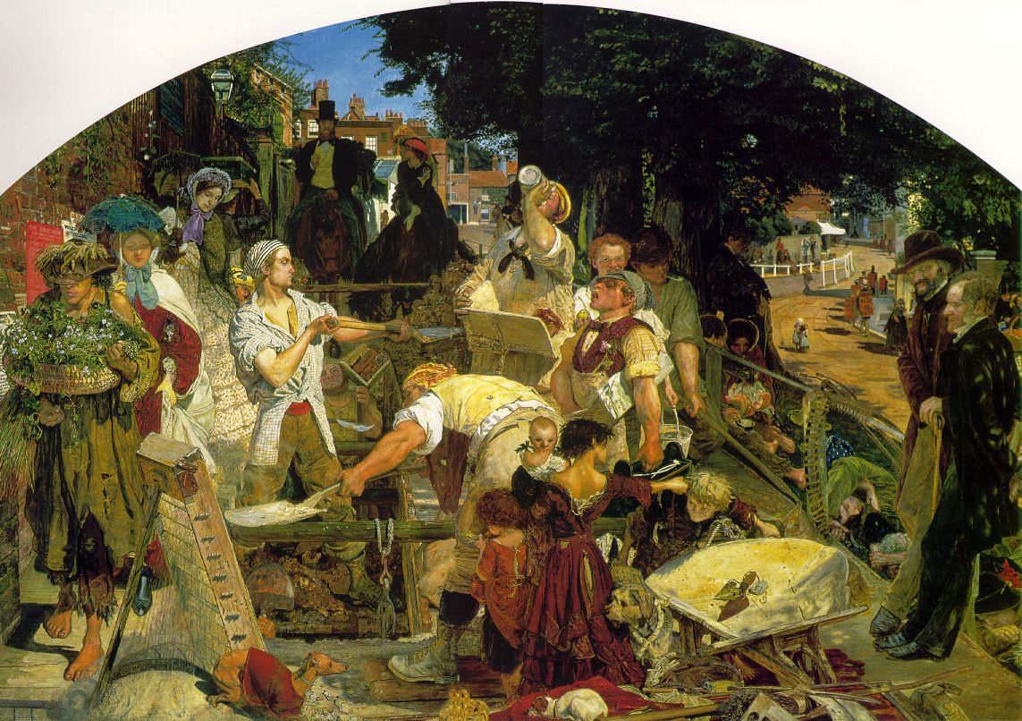
Co-construct
Share
Agenda shaping and facilitating
Resources
Documentation, curation
Our stories

Slide 6
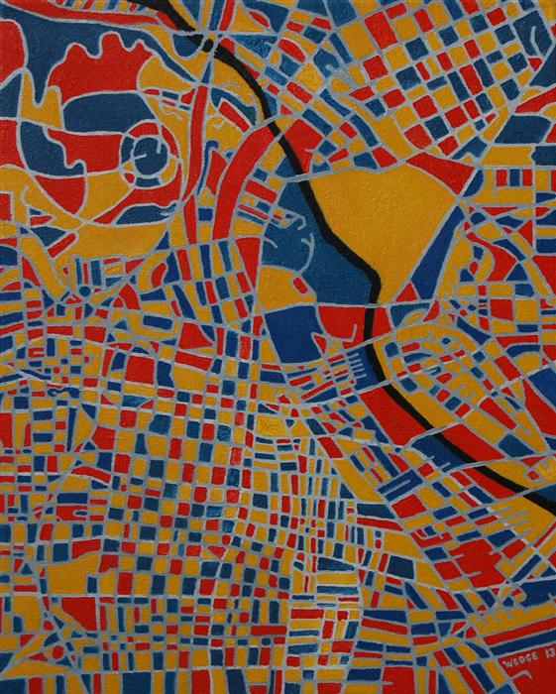
When we were together last:
“The foundation of generative social-impact networks is the connectivity of its members to each other, which be cultivated by network weavers.”
Connecting to Change the World, Plastrik, Taylor and Cleveland)
Naava Frank–a tool for increasing connection
Working Out Loud
https://www.jewishrecon.org/networks/2017/network-builders
Suri Jacknis—how to set goals and measure impact on individuals and the whole of the network. The use of Salesforce to capture data.

Slide 7
Today
Explore the Questions: How do we live the values in our networks?
Mind the Gap
Espoused and Lived values

Slide 8
Values in an organization vs a network
Organizational Culture:
A system of meaning, commonly understood as “how we do things around here,” that manifests in artifacts, norms, values, and assumptions;
Consider:
How an organization’s espoused values are (or are not) expressed to employees, participants, and partners through policies, behaviors/practices, and decisions; and assumptions.
Identify:
What actions can they take to bring the culture that their employees, participants, and partners experience into greater alignment with the values they espouse.

Slide 9
Guided imagery exercise
Guided Imagery:
First experience with your network or this network
Consider how a newcomer first engages with your network.
Debrief in small groups
Dr. Rob Weinberg’s handout from Kenissa

Slide 10
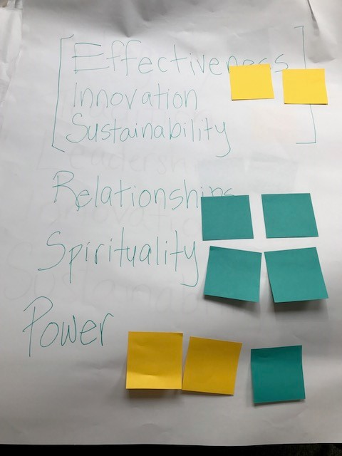
Values in a network vs. organization
Questions to consider:
What happens when values of the network are different than the values of the organization a member primarily belongs to?
How do you negotiate the space between the two?
How can a network live its values when its members are geographically disperse?

Slide 11
Take-aways and Next Steps
February 21, 1:00-2:15 pm est
April 18, 1:00-2:15 pm est
May 23, 1:00-2:15 pm est

