Slide 1
Can you hear me now? How can we harness the power of word of mouth?
Meeting 2
November 15, 2017; 8 p.m. EST
Rachael Burgess Major Gifts Officer at RRC & Jewish Reconstructionist Communities

Slide 2
Agenda: Who is an influencer?
Case study #1
Qualities of an influencer
Six Degrees of Separation
Gladwell’s “Connector” Experiment
Case study #2
Resources
Notes:
Our agenda for 11/15/17: Who is an influencer?

Slide 3
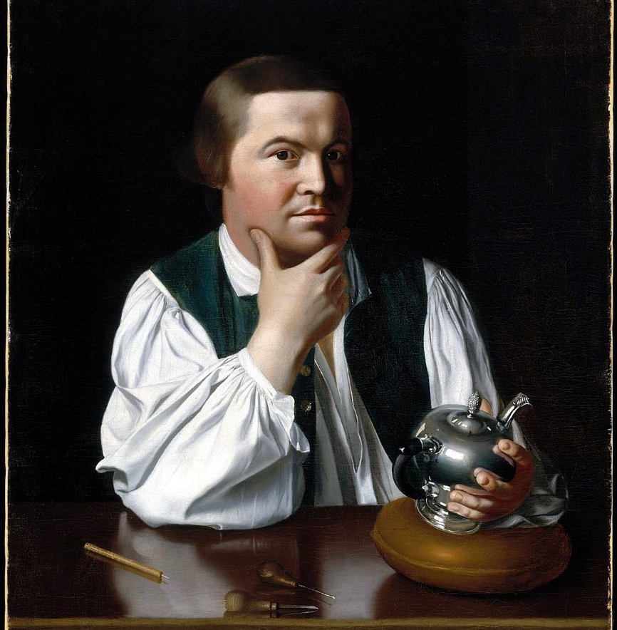
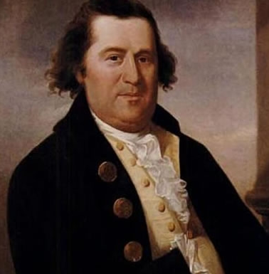
Case Study #1
Paul Revere
William Dawes
https://en.wikipedia.org/wiki/Paul_Revere
http://www.history.com/news/the-midnight-ride-of-william-dawes
Notes:
On April 18, 1775, a stable boy in Boston overheard two British soldiers talking about an attack on Lexington (to arrest John Handcock and Samuel Adams) and march onward to Concord. This confirmed many rumors that the British were planning to attack the next day.
A silver smith and a tanner hopped on their horses and rode through to Concord to warn the local militias that the British were on the way.

Slide 4
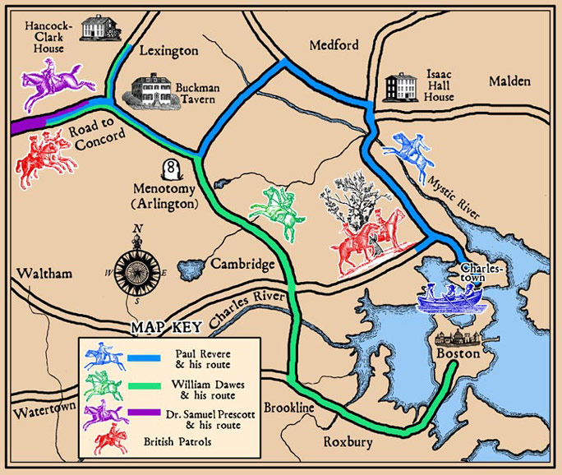
http://thehistoryjunkie.com/paul-revere-and-william-dawes/
Notes:
Paul Revere took a northern route. Bells rang out, drums played, and the local militias met the British troops. This was the start of the American Revolution.
William Dawes took a southern route and had less success. The news did not spread and few people were prepared when the British troops came. In fact, so few Colonists met the British, Historians thought that towns like Waltham were Pro-British… which was not the case at all. The townspeople never received the message.

Slide 5
Case Study #1
Paul Revere
William Dawes
Both Colonial patriots
Both brave
Same message
Started at the same time
Similar routes
Notes:
Both men were patriots of the Colonists and bravely road across Massachusetts through the dead of night in order to warn the local militias of the upcoming attack.

Slide 6
Case Study #1
Paul Revere
William Dawes
Well connected in the area
Involved in government and grassroots organizations
Knew the right people to reach
In the inner circle of the Revolutionaries
Private businessman
Not involved in many organizations
Not well connected
Not as familiar with the local townspeople
Didn’t carry the same credibility
Notes:
What made Paul’s ride more successful than William’s?
Paul was Commissioned a second lieutenant in a provincial artillery regiment during the French-Indian War, served as a dentist and even sat on a committee that helped Boston install its first street lights. He was an active protestor against the Stamp Act and other British taxes. He made valuable connections through his membership as a free-mason. He was so highly regarded, he had a successful career in politics, asked to chair grand juries, and died a successful businessman.
William was really none of the above.

Slide 7
Qualities of an Influencer
Know many people
Involved in the larger community
Approachable
Persuasive
Notes:
They must have large networks of friends and acquaintances. (Quantity matters)
Many build their networks by participating in many organizations or event at a government level. But having someone intimate with your organization and respected in your community is key.
They must be nice people who try to be helpful. People you can tell have the best of intentions. Not only do they know people, they are good with people. They build meaningful relationships. (Quality also matters)
This person should be able to be persuasive enough to be able to convince people to get more involved or to take action. We’re not talking about a bully or arm wrestler, but someone who is not afraid to ask.

Slide 8
Six Degrees of Separation
Notes:
The idea of “Six Degrees of Separation” has been studied since the 1920s. After WWI, people began to travel more and open their networks of acquaintances. Hungarian author Frigyes Karinthy published a short story called “Chains,” where characters explored whether they could connect themselves to anyone in the world in fewer than 5 steps.
In 1967, American psychologist Stanley Milgram continued working on the “small-world problem.” He selected 160 names from Nebraska and sent them packages. He asked each participant to send the package to someone they knew who could get the package closer to a stock broker that lived in Sharon, Massachusetts and worked in Boston.

Slide 9
Six Degrees of Separation
How we think it works…
https://visualisingadvocacy.org/sites/drawingbynumbers.ttc.io/files/networks1.png
Notes:
Milgram found that most of the packages reached the stock broker in about 5 steps.
According to studies conducted by Facebook, social media has perhaps lowered this to about 4 steps.
This led us to think that each of us is some how connected to all people through just a few acquaintances. But it’s a bit more complicated than that…

Slide 10
Six Degrees of Separation
What Milgram found…
https://visualisingadvocacy.org/sites/drawingbynumbers.ttc.io/files/networks1.png
Notes:
So while the packages made their way to this stock broker in roughly 5 steps, 16 out of the 24 packages came to his home in Sharon, Mass. through one person, “Mr. Jacobs.”
The rest of the packages reached the stock broker at his Boston office, though nearly half of those packages came to him through two people, “Mr. Brown” and “Mr. Jones.”

Slide 11
Gladwell’s “Connector” Experiment:
Algazi, Alvarez, Alpern, Ametrano, Andrews, Aran, Arnstein, Ashford, Bailey, Ballout, Bamberger, Baptista, Barr, Barrows, Baskerville, Bassiri, Bell, Bokgese, Brandao, Bravo, Brooke, Brightman, Billy, Blau, Bohen, Bohn, Borsuk, Brendle, Butler, Calle, Cantwell, Carrell, Chinlund, Cirker, Cohen, Collas, Couch, Callegher, Calcaterra, Cook, Carey, Cassell, Chen, Chung, Clarke, Cohn, Carton, Crowley, Curbelo, Dellamanna, Diaz, Dirar, Duncan, Dagostino, Delakas, Dillon, Donaghey, Daly, Dawson, Edery, Ellis, Elliott, Eastman, Easton, Famous, Fermin, Fialco, Finklestein, Farber, Falkin, Feinman, Friedman, Gardner, Gelpi, Glascock, Grandfield, Greenbaum Greenwood, Gruber, Garil, Goff, Gladwell, Greenup, Gannon, Ganshaw, Garcia, Gennis, Gerard, Gericke, Gilbert, Glassman, Glazer, Gomendio, Gonzalez, Greenstein, Guglielmo, Gurman, Haberkorn, Hoskins, Hussein, Hamm, Hardwick, Harrell, Hauptman, Hawkins, Henderson, Hayman, Hibara, Hehmann, Herbst, Hedges, Hogan, Hoffman, Horowitz, Hsu, Huber, Ikiz, Jaroschy, Johann, Jacobs, Jara, Johnson, Kassel, Keegan, Kuroda, Kavanau, Keller, Kevill, Kiew, Kimbrough, Kline, Kossoff, Kotzitzky, Kahn, Kiesler, Kosser, Korte, Leibowitz, Lin, Liu, Lowrance, Lundh, Laux, Leifer, Leung, Levine, Leiw, Lockwood, Logrono, Lohnes, Lowet, Laber, Leonardi, Marten, McLean, Michaels, Miranda, Moy, Marin, Muir, Murphy, Marodon, Matos, Mendoza, Muraki, Neck, Needham, Noboa, Null, O’Flynn, O’Neill, Orlowski, Perkins, Pieper, Pierre, Pons, Pruska, Paulino, Popper, Potter, Purpura, Palma, Perez, Portocarrero, Punwasi, Rader, Rankin, Ray, Reyes, Richardson, Ritter, Roos, Rose, Rosenfeld, Roth, Rutherford, Rustin, Ramos, Regan, Reisman, Renkert, Roberts, Rowan, Rene, Rosario, Rothbart, Saperstein, Schoenbrod, Schwed, Sears, Statosky, Sutphen, Sheehy, Silverton, Silverman, Silverstein, Sklar, Slotkin, Speros, Stollman, Sadowski, Schles, Shapiro, Sigdel, Snow, Spencer, Steinkol, Stewart, Stires, Stopnik, Stonehill, Tayss, Tilney, Temple, Torfield, Townsend, Trimpin, Turchin, Villa, Vasillov, Voda, Waring, Weber, Weinstein, Wang, Wegimont, Weed, Weishaus.
Notes:
“What makes someone a Connector? The first–and most obvious–criterion is that Connectors know lots of people. They are the kinds of people who know everyone. All of us know someone like this. But I don’t think that we spend a lot of time thinking about the importance of these kinds of people. I’m not even sure that most of us really believe that the kind of person who knows everyone really knows everyone. But they do. There is a simple way to show this. In the paragraph below is a list of around 250 surnames, all taken at random from the Manhattan phone book. Go down the list and give yourself a point every time you see a surname that is shared by someone you know. (The definition of “know” here is very broad. It is if you sat down next to that person on a train, you would know their name if they introduced themselves to you, and they would know your name.) Multiple names count. If the name is Johnson, in other words, and you know three Johnsons, you get three points. The idea is that your score on this test should roughly represent how social you are. It’s a simple way of estimating how many friends and acquaintances you have.”
I got a nice score of 48, which is higher than average for my 20-30 year-old age group. People in their 50-60’s can expect a higher score because they’ve had time to build those networks.
I asked my friend Jared Jackson of Jews of all Hues to do this. I knew him from college, but many of my colleagues and even a few people in our network are connected to him via Facebook. He had a score of 257.

Slide 12
Case Study #2
Notes:
I met with a board member in my office to talk about how to get his congregation more involved in movement-wide activities like the Reconstructionist Learning Networks.
Naturally, I told him all of the things we were doing to promote our activities at the movement level. This included social media, some social media advertising, and two monthly newsletters called “Reconstructionism Today” and “Leadership Brief.” Both of these newsletters were projects I played a heavy role in when I was in the communications department.

Slide 13
Case Study #2
“You are your own example.”
-Katherine Swank
Notes:
He told me that he receives them, but he doesn’t really read them. We asked him questions about whether or not it had to do with our content. Was it not interesting or relevant? Was it difficult to read?
He told us that he was so inundated with email that he just did not time to read it all. Which is not completely a surprise. Studies found that more than 40% of people delete email without even opening them.
However, a resource we were promoting in “Leadership Brief” (a Torah study for board meetings) he began using because his rabbi saw the resources forwarded it to him via email.
I asked him, “When you ‘triage’ your inbox, who will you open emails from?”
He gave me a list of people because he knew that the people forwarding him the information were knowledgeable and knew the content would apply to him.
So we talked about how we could utilize those people in order to spread messages to the rest of the community, like asking the person to read our newsletters and only forward them on if they are relevant.
I also notice that when he reached out to me, it was in response to an email I sent him about a program, not from one of our advertisements.
We are more likely to respond and act when someone we trust persuades us to.

Slide 14
Resources
The Tipping Point: How Little Things Can Make a Big Difference by Malcom Gladwell
The Science of Six Degrees of Separation (video)
“Six Degrees of Separation? Facebook Finds a Smaller Number” By Jonah Bromwich, New York Times FEB. 4, 2016
Three and a half degrees of separation by Facebook Research
Klout
https://en.wikipedia.org/wiki/Klout

Slide 15
Need help?
Connect to each other
Post a question to our Facebook group: www.facebook.com/groups/canyouhearmenowRLN/
Email or call Rachael Burgess
(rburgess@rrc.edu or 215.576.0800; ext. 141)

